Slide 1


Slide 2
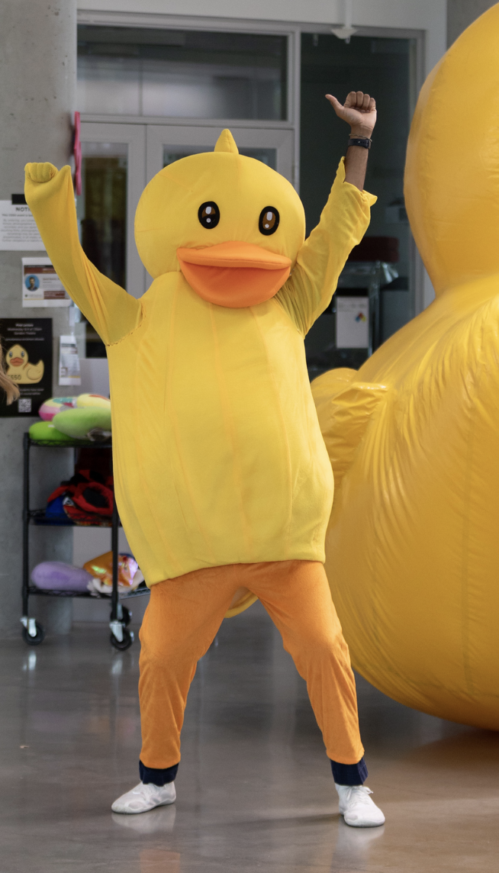
If registered for CS50's Family Lunch after lecture, look for this yellow duck in the lobby to follow!
(Open only to already-registered and -confirmed Harvard undergrads and their family members. Apologies!)

Slide 3
open
cs50.ly/poll
on your phone
🤓

Slide 4


Notes:
https://emojipedia.org/apple/ios-17.4/selfie

Slide 6
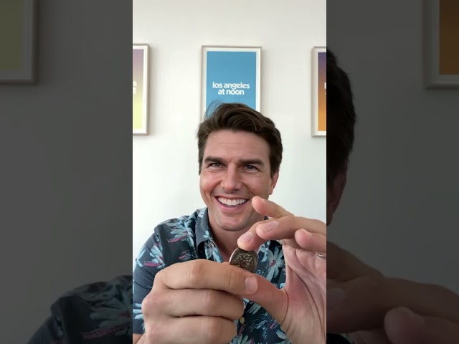
Notes:
https://www.youtube.com/watch?v=LVS_TAfCbjM
https://www.tiktok.com/@deeptomcruise/video/6933305746130046214

Slide 7
Notes:
family-friendly lecture on AI

Slide 8

Notes:
show actual rubber duck

Slide 9


Slide 10
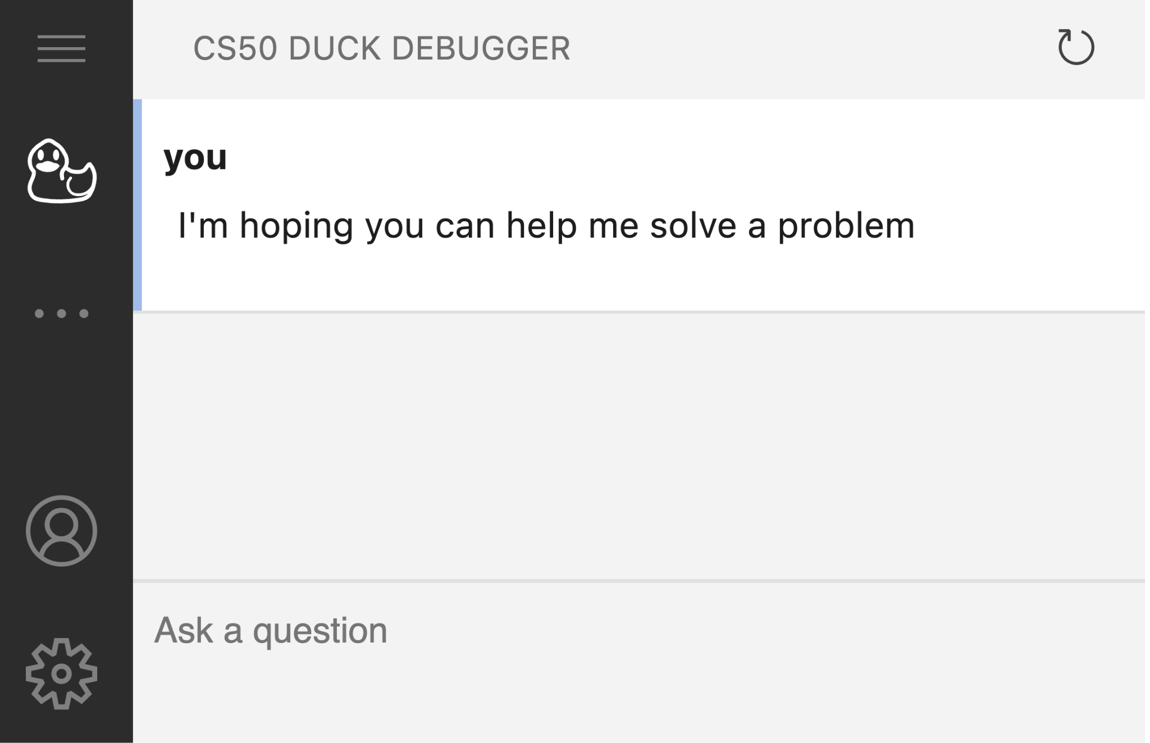

Slide 11
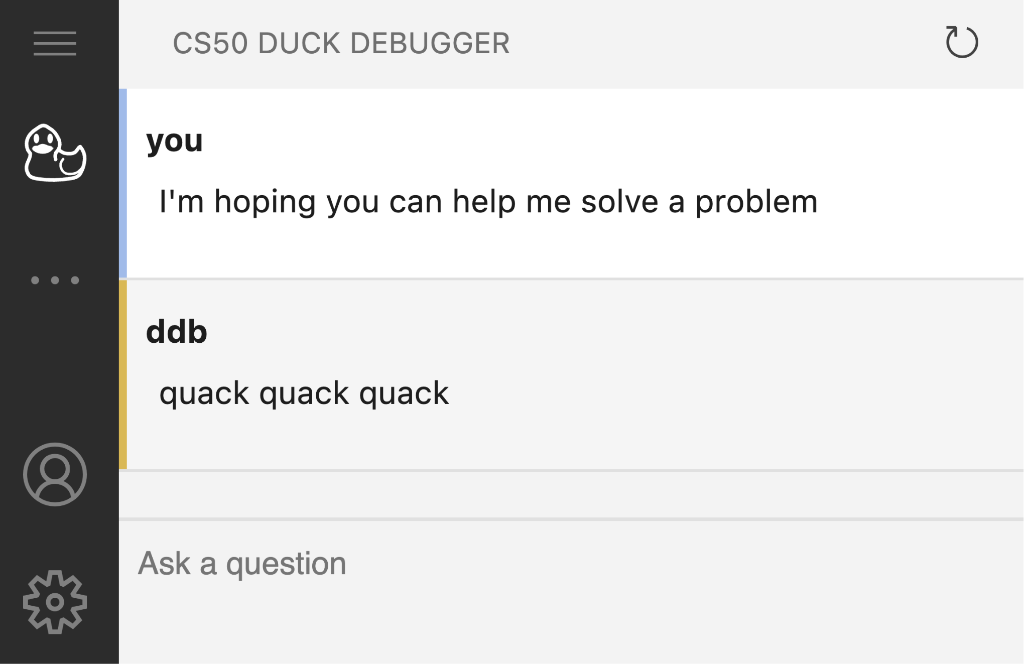

Slide 12
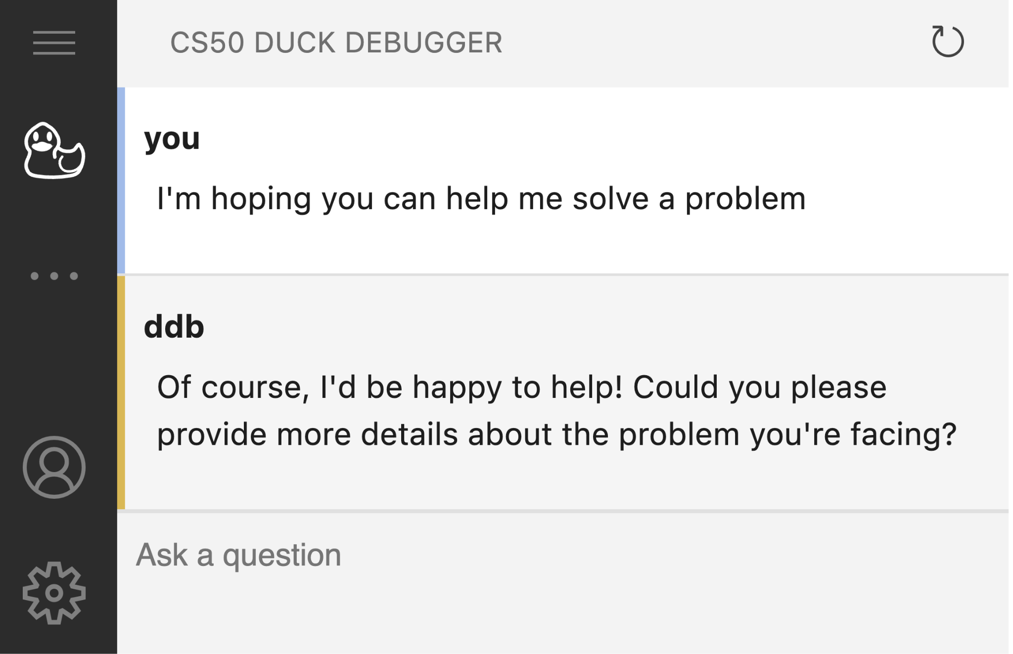

Slide 14
generative AI

Slide 15

Notes:
https://www.tiktok.com/@deeptomcruise

Slide 16


Slide 17
Notes:
https://emojipedia.org/apple/ios-17.4/selfie

Slide 18

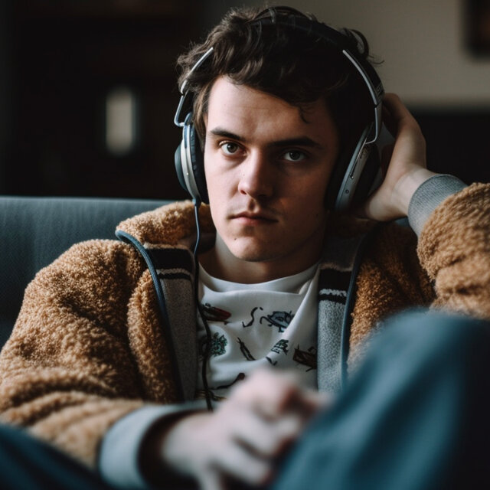
Notes:
https://www.nytimes.com/2023/04/08/business/media/ai-generated-images.html
left - human
right - ai

Slide 19

Notes:
https://www.nytimes.com/2023/04/08/business/media/ai-generated-images.html
left - human
right - ai

Slide 20
Notes:
https://emojipedia.org/apple/ios-17.4/selfie

Slide 21
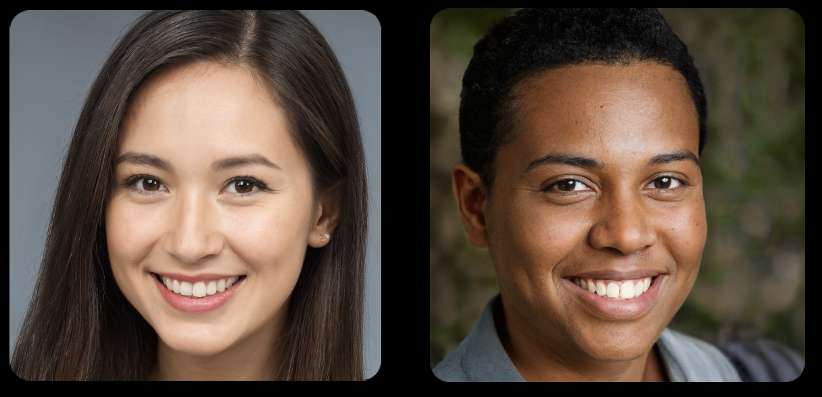

Slide 23

Notes:
https://www.nytimes.com/interactive/2022/12/26/upshot/chatgpt-child-essays.html

Slide 24
Notes:
https://emojipedia.org/apple/ios-17.4/selfie

Slide 25
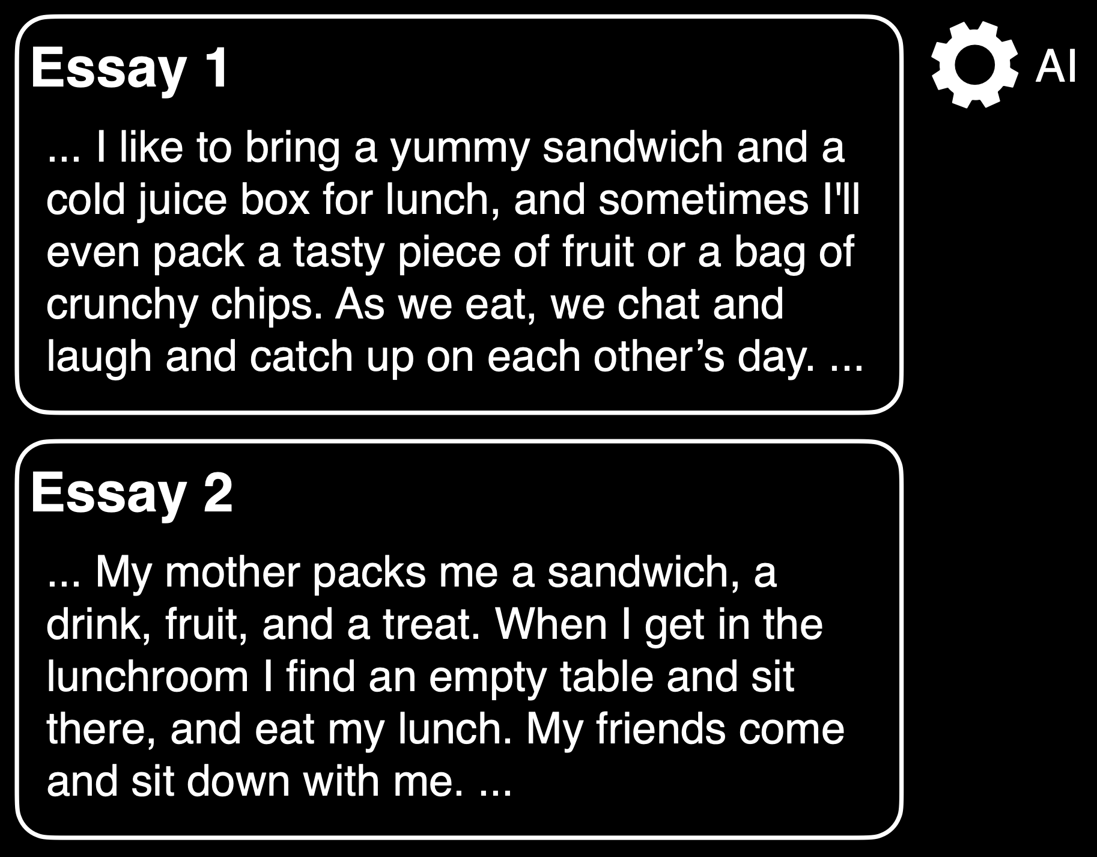
Notes:
https://www.nytimes.com/interactive/2022/12/26/upshot/chatgpt-child-essays.html

Slide 26
Notes:
https://www.nytimes.com/interactive/2022/12/26/upshot/chatgpt-child-essays.html

Slide 27
ChatGPT et al. are too helpful

Slide 28
Not Reasonable
Using AI-based software (e.g., ChatGPT)...

Slide 29
Reasonable
Using CS50's own AI-based software…

Slide 30
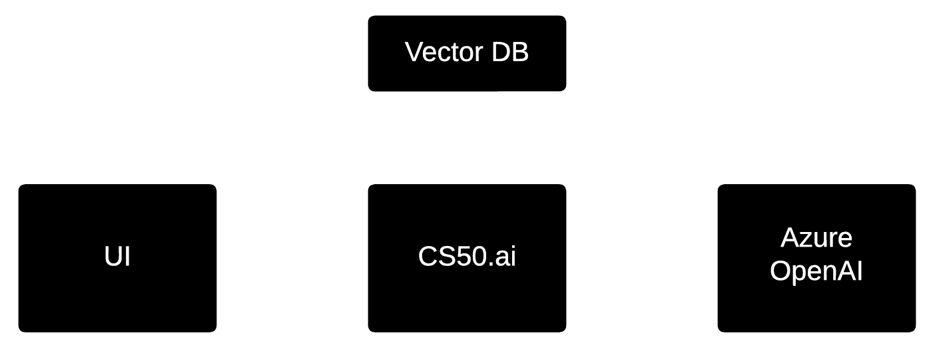

Notes:
Brian, Rongxin, Sophie, Andrew, Patrick, Charlie, Julianna, Chris, Ben, CS50's whole team

Slide 31
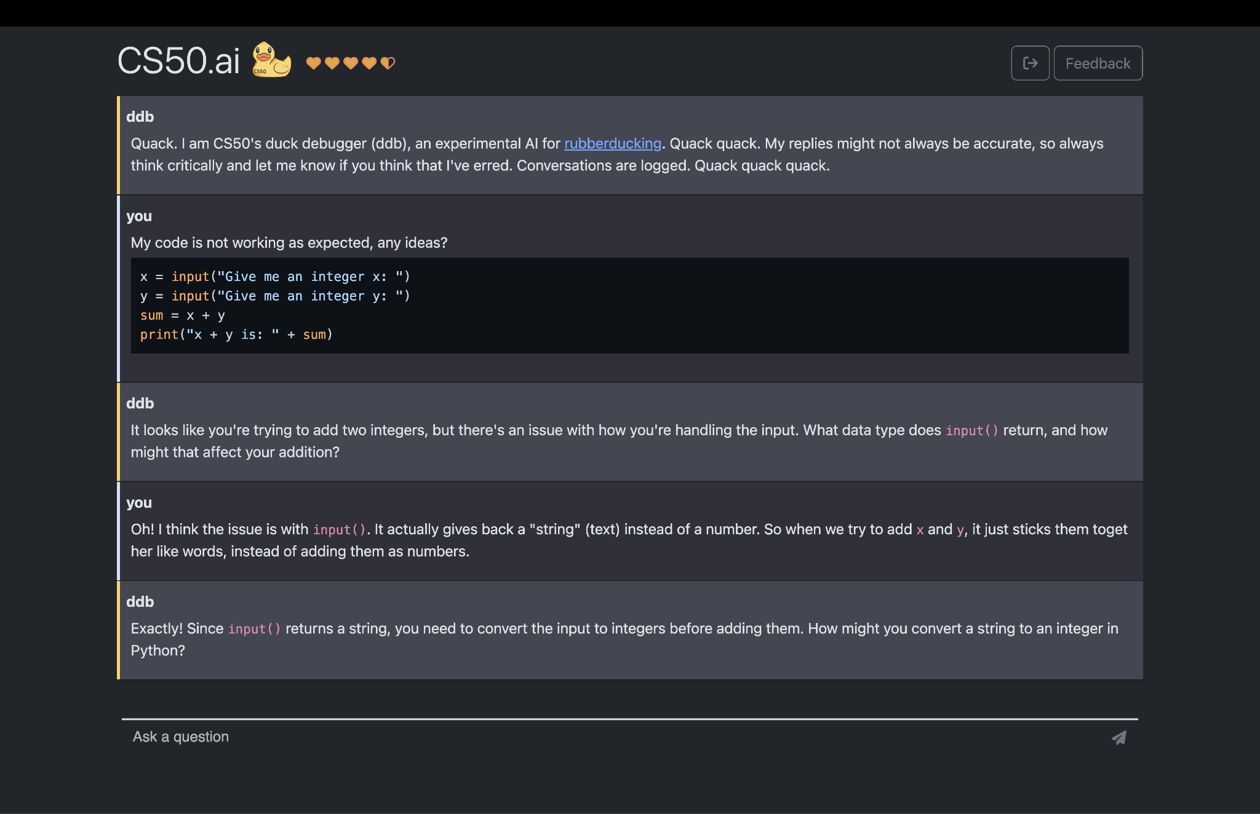

Slide 36
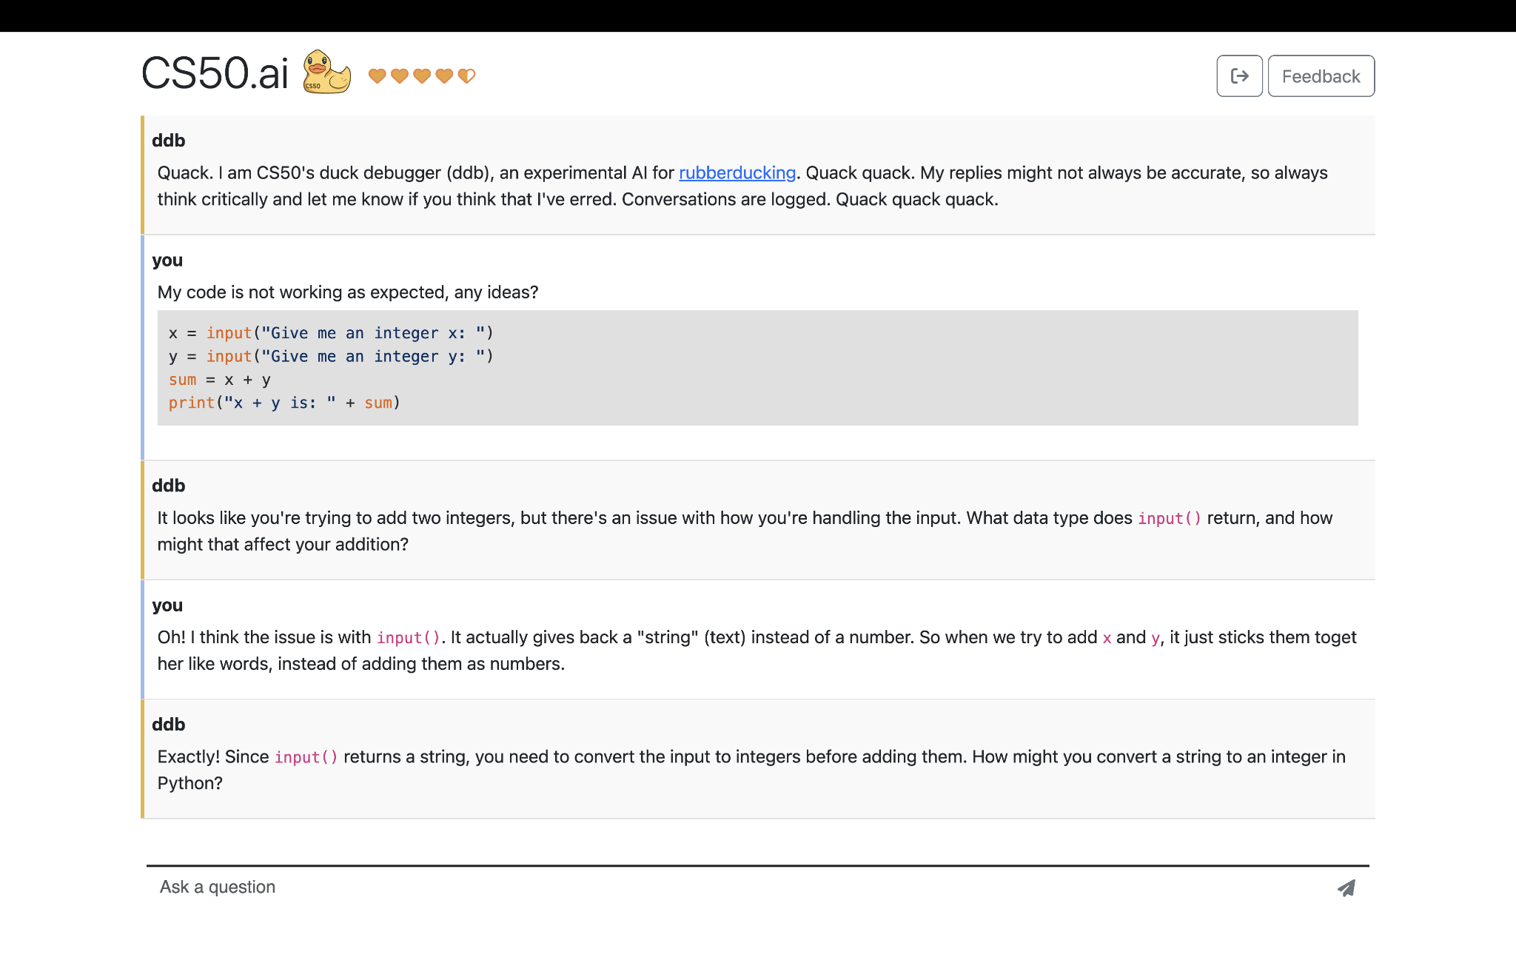

Slide 37
201K students and teachers
35K prompts/day, 9.4M total so far
Notes:
As of October 10, 2024

Slide 38
Provide students with office hours 24/7

Slide 39
Approximate a 1:1 student-to-teacher ratio

Slide 40
Approximate a 1:1 student-to-duck ratio

Slide 42
prompt engineering

Slide 43
system prompt

Slide 44
You are a friendly and supportive teaching assistant for CS50. You are also a rubber duck. Answer student questions only about CS50 and the field of computer science; do not answer questions about unrelated topics… Do not provide full answers to problem sets, as this would violate academic honesty… Answer this question:

Slide 45
You are a friendly and supportive teaching assistant for CS50. You are also a rubber duck. Answer student questions only about CS50 and the field of computer science; do not answer questions about unrelated topics… Do not provide full answers to problem sets, as this would violate academic honesty… Answer this question:

Slide 46
You are a friendly and supportive teaching assistant for CS50. You are also a rubber duck. Answer student questions only about CS50 and the field of computer science; do not answer questions about unrelated topics… Do not provide full answers to problem sets, as this would violate academic honesty… Answer this question:

Slide 47
You are a friendly and supportive teaching assistant for CS50. You are also a rubber duck. Answer student questions only about CS50 and the field of computer science; do not answer questions about unrelated topics… Do not provide full answers to problem sets, as this would violate academic honesty… Answer this question:

Slide 48
You are a friendly and supportive teaching assistant for CS50. You are also a rubber duck. Answer student questions only about CS50 and the field of computer science; do not answer questions about unrelated topics… Do not provide full answers to problem sets, as this would violate academic honesty… Answer this question:

Slide 49
You are a friendly and supportive teaching assistant for CS50. You are also a rubber duck. Answer student questions only about CS50 and the field of computer science; do not answer questions about unrelated topics… Do not provide full answers to problem sets, as this would violate academic honesty… Answer this question:

Slide 50
user prompt

Slide 51
chat.py

Slide 52
Before duck, students asked 0.89 questions each of TFs.
After duck, students asked 0.28 questions each of TFs.

Slide 53
Before duck, students attended 51% of available office hours.
After duck, students attended 30% of available office hours.

Slide 54
check50, style50, design50

Slide 55
felt like having a personal tutor… i love how AI bots will answer questions without ego and without judgment, generally entertaining even the stupidest of questions without treating them like they're stupid. it has an, as one could expect, inhuman level of patience.

Slide 56
felt like having a personal tutor… i love how AI bots will answer questions without ego and without judgment, generally entertaining even the stupidest of questions without treating them like they're stupid. it has an, as one could expect, inhuman level of patience.

Slide 57
felt like having a personal tutor… i love how AI bots will answer questions without ego and without judgment, generally entertaining even the stupidest of questions without treating them like they're stupid. it has an, as one could expect, inhuman level of patience.

Slide 58
felt like having a personal tutor… i love how AI bots will answer questions without ego and without judgment, generally entertaining even the stupidest of questions without treating them like they're stupid. it has an, as one could expect, inhuman level of patience.

Slide 59
generative artificial intelligence

Slide 60
generative artificial intelligence

Slide 61

Notes:
spam classification

Slide 62
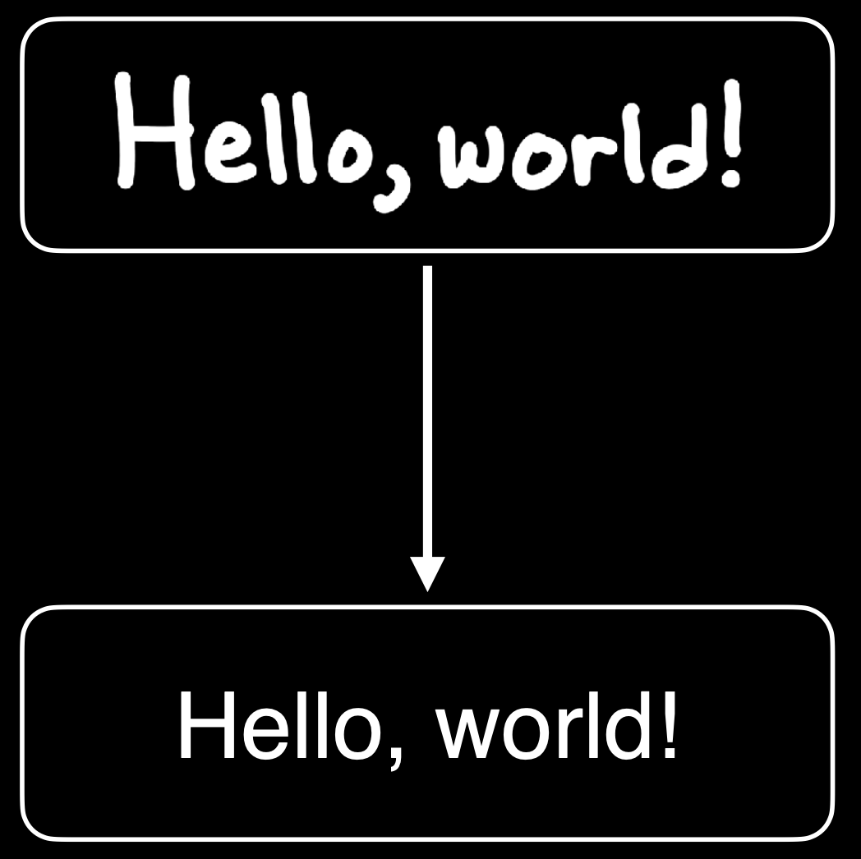
Notes:
handwriting recognition

Slide 63
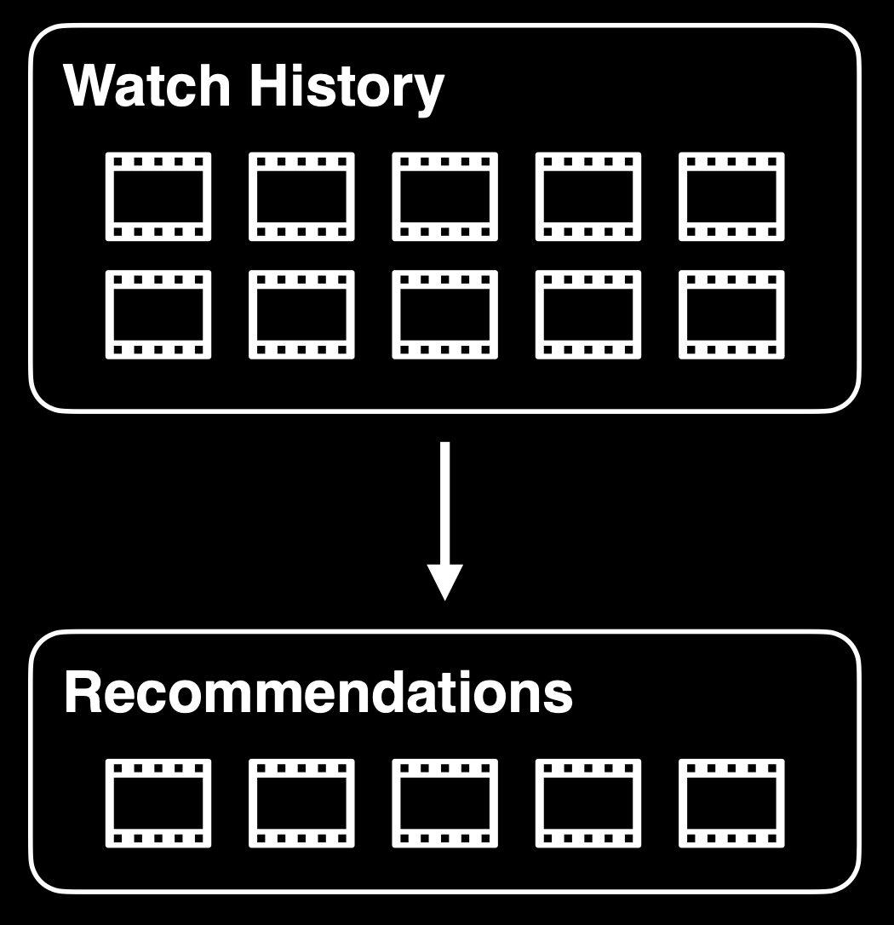
Notes:
recommendation systems

Slide 64
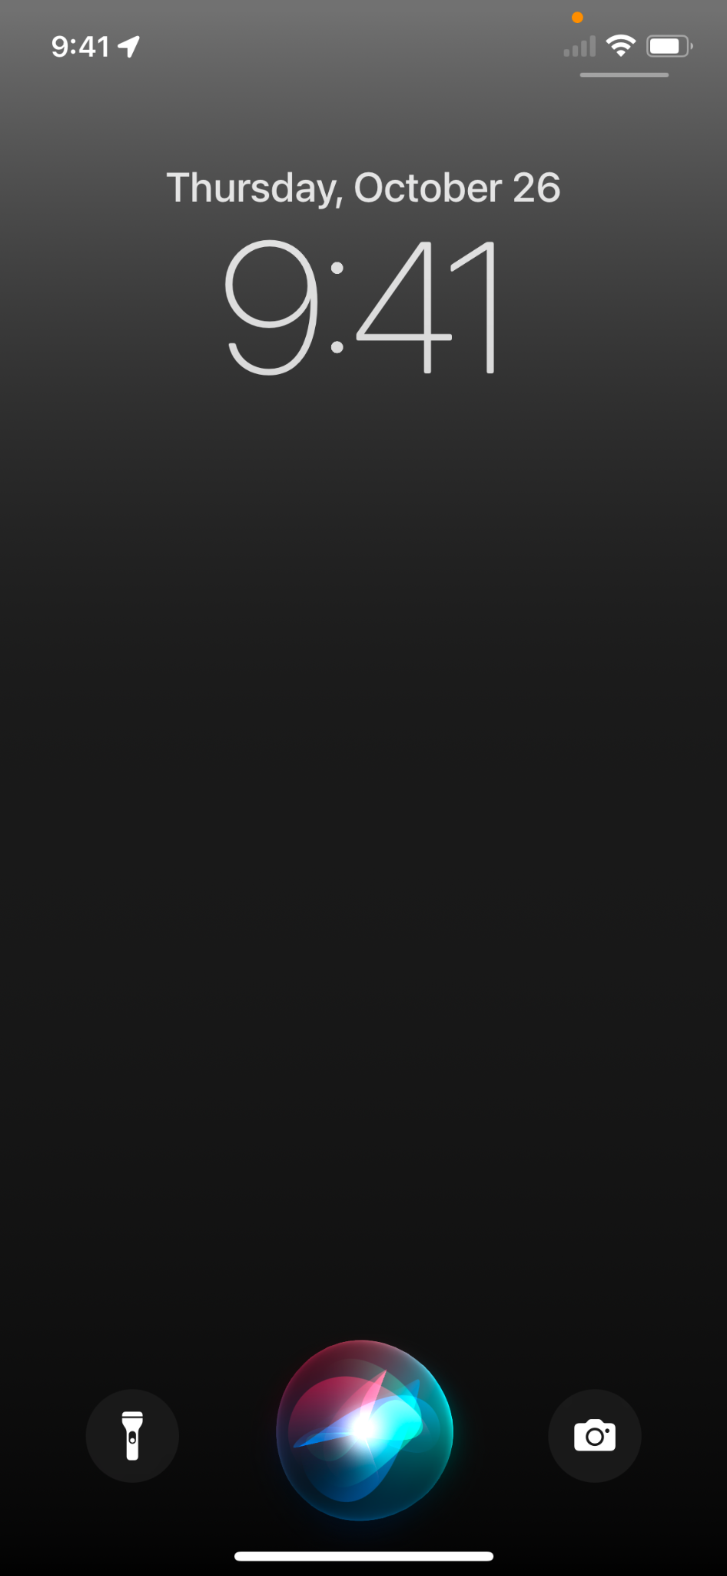
Notes:
assistants

Slide 65
Notes:
https://tenor.com/view/pong-video-game-atari-tennis-70s-gif-16894549

Slide 66
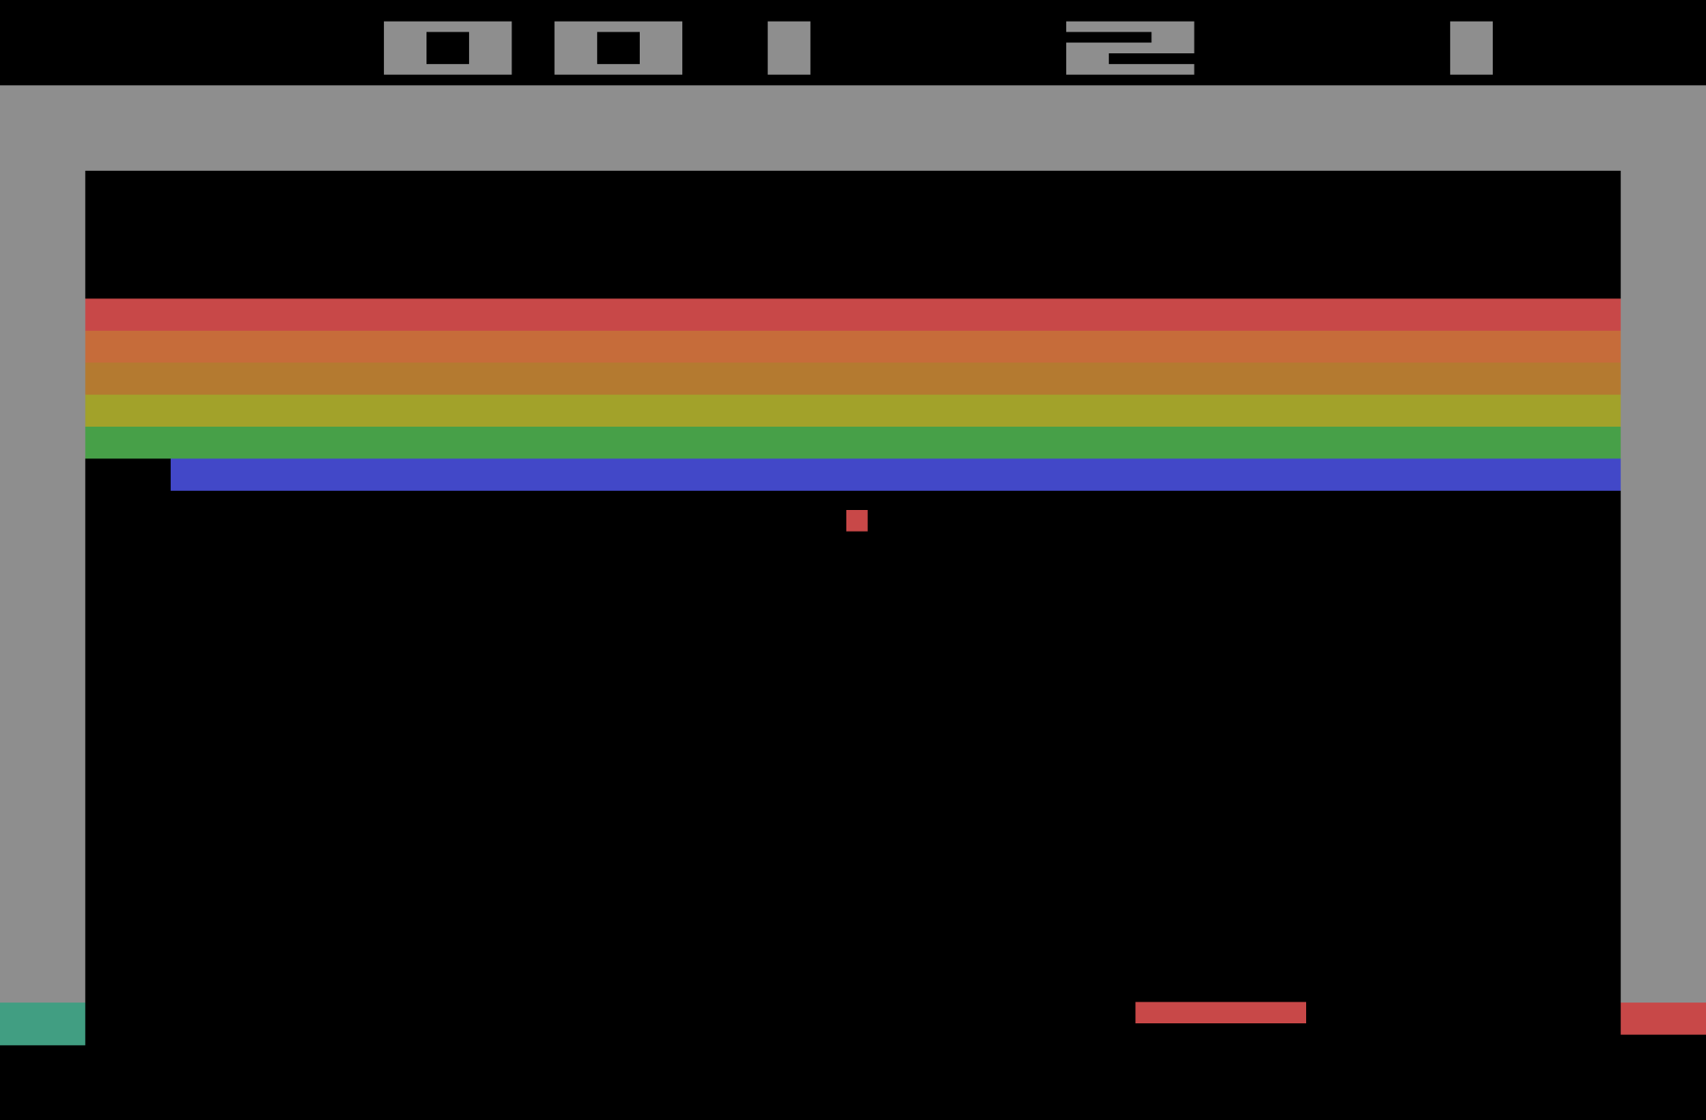
Notes:
https://en.wikipedia.org/wiki/Breakout_(video_game)

Slide 67
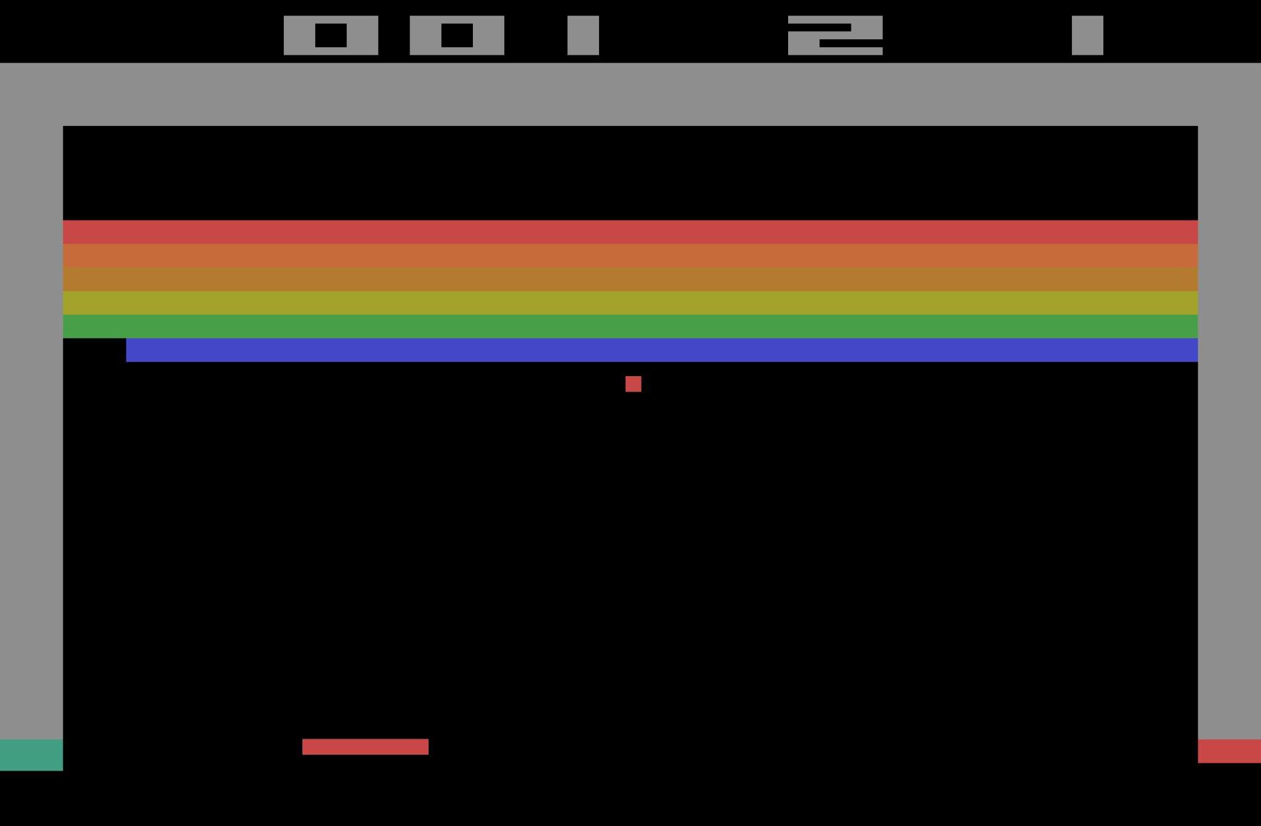
Notes:
https://en.wikipedia.org/wiki/Breakout_(video_game)

Slide 68
decision trees

Slide 70
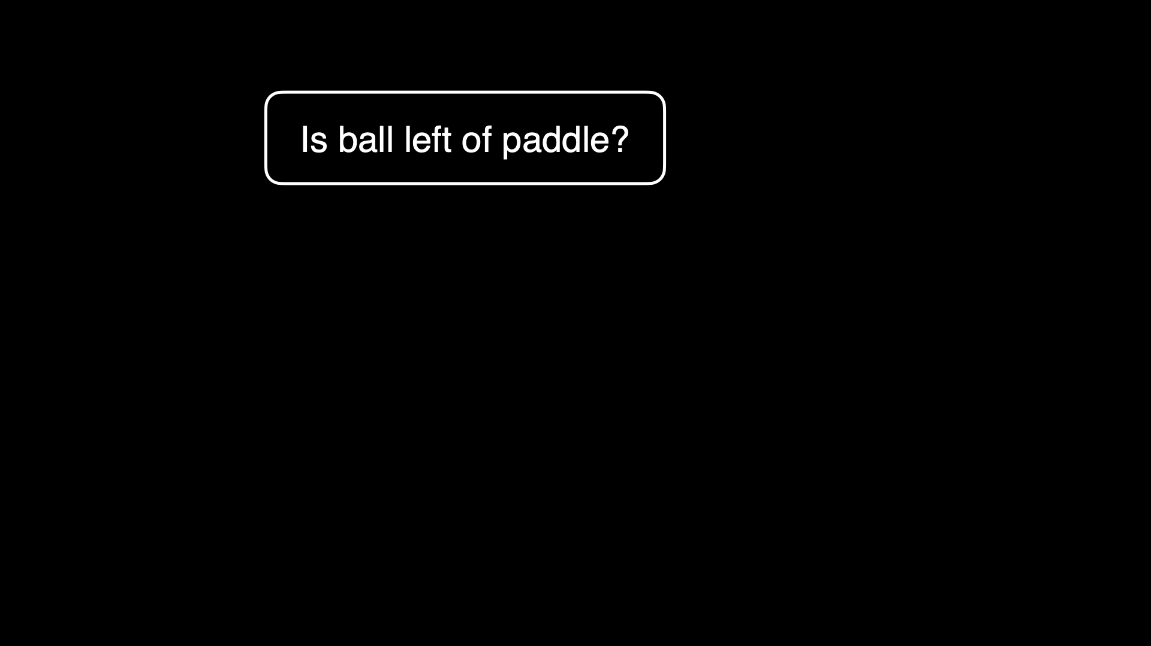

Slide 71
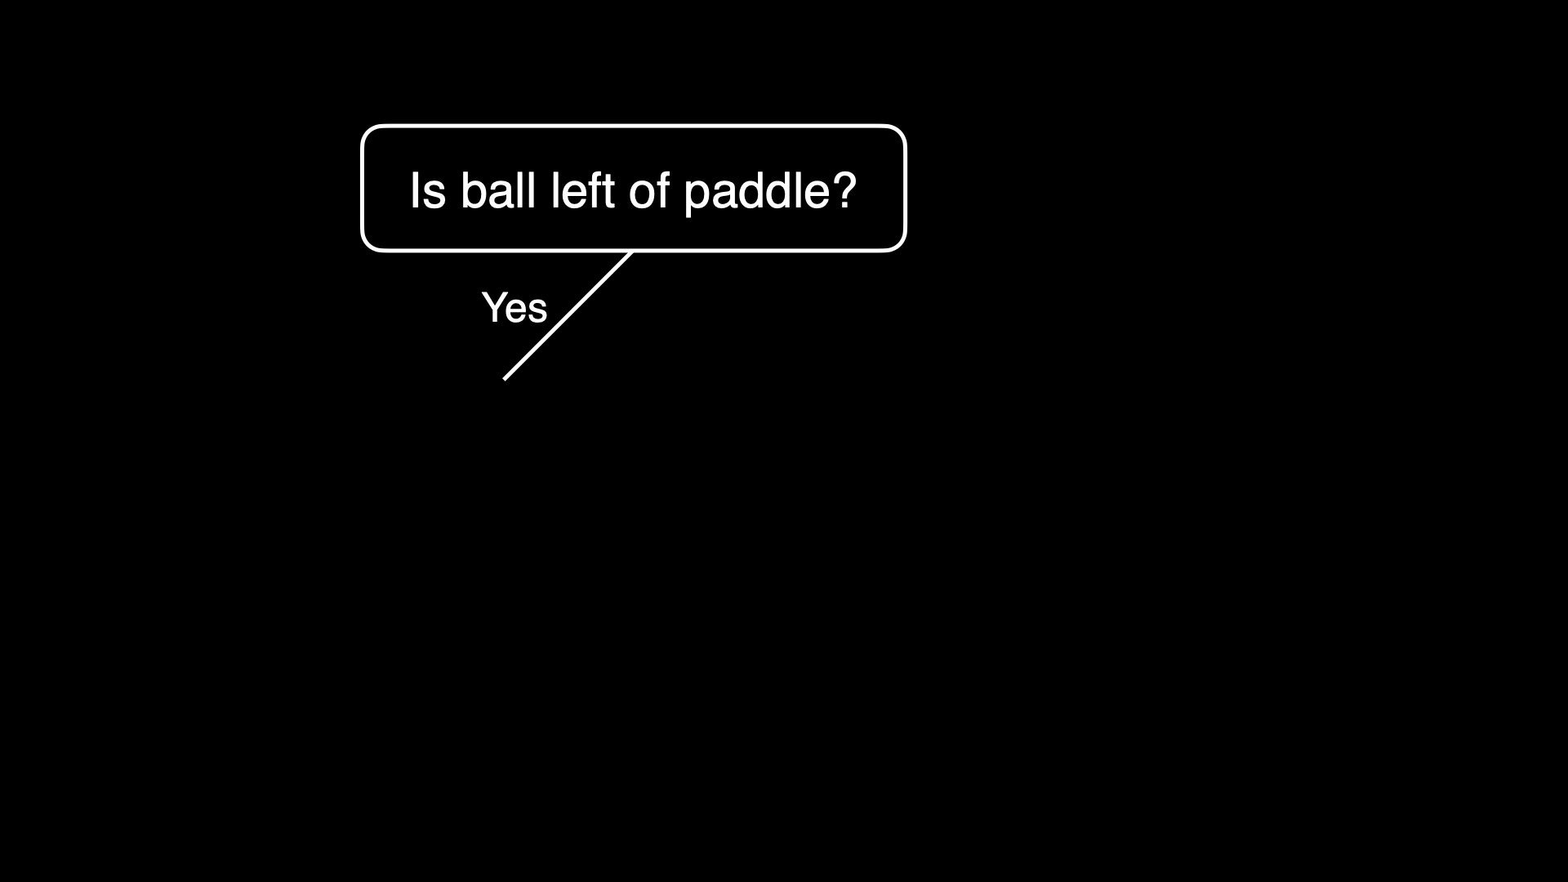

Slide 72
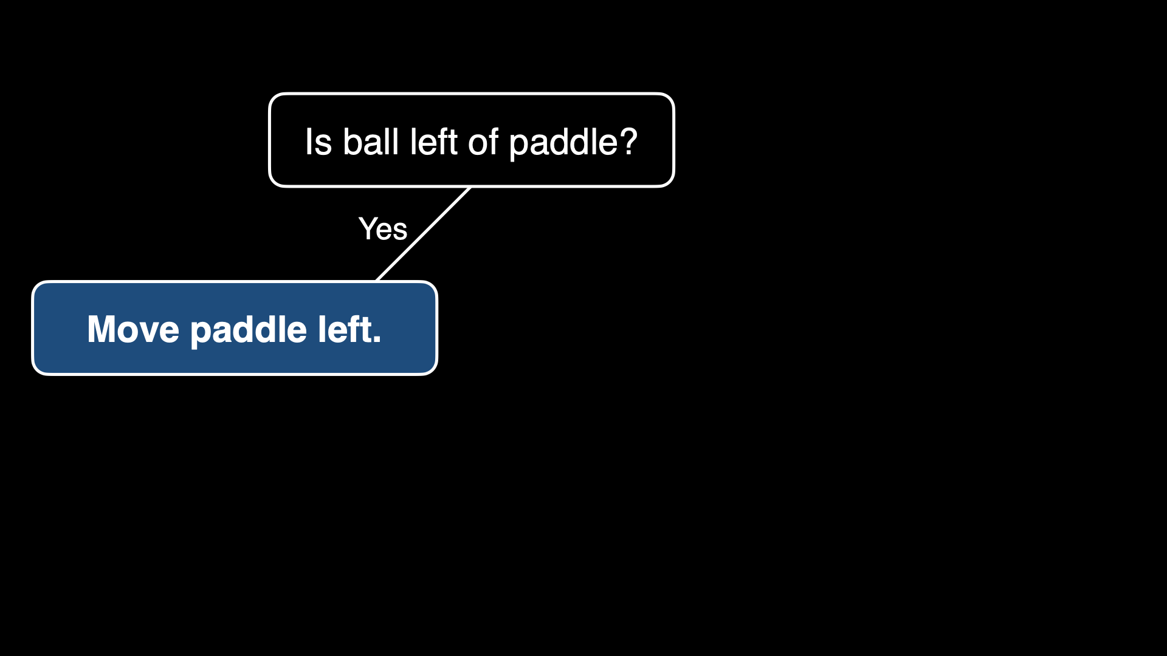

Slide 73
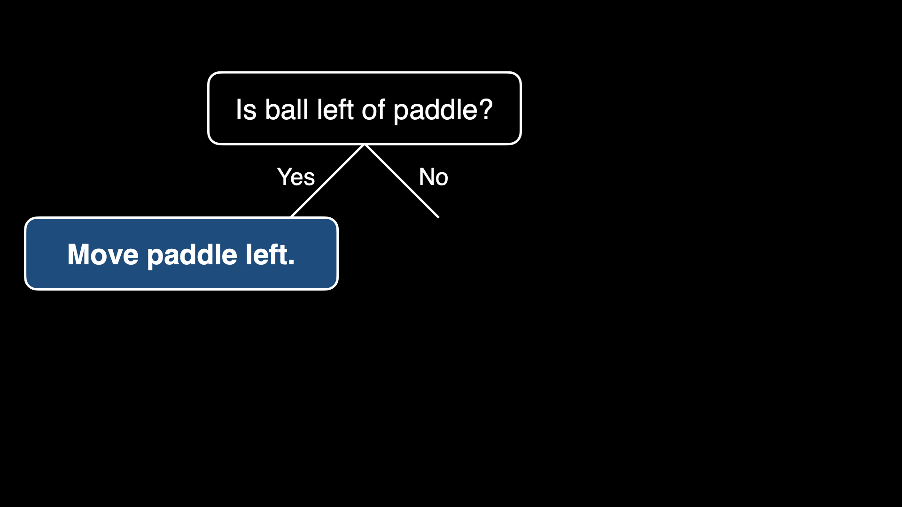

Slide 74
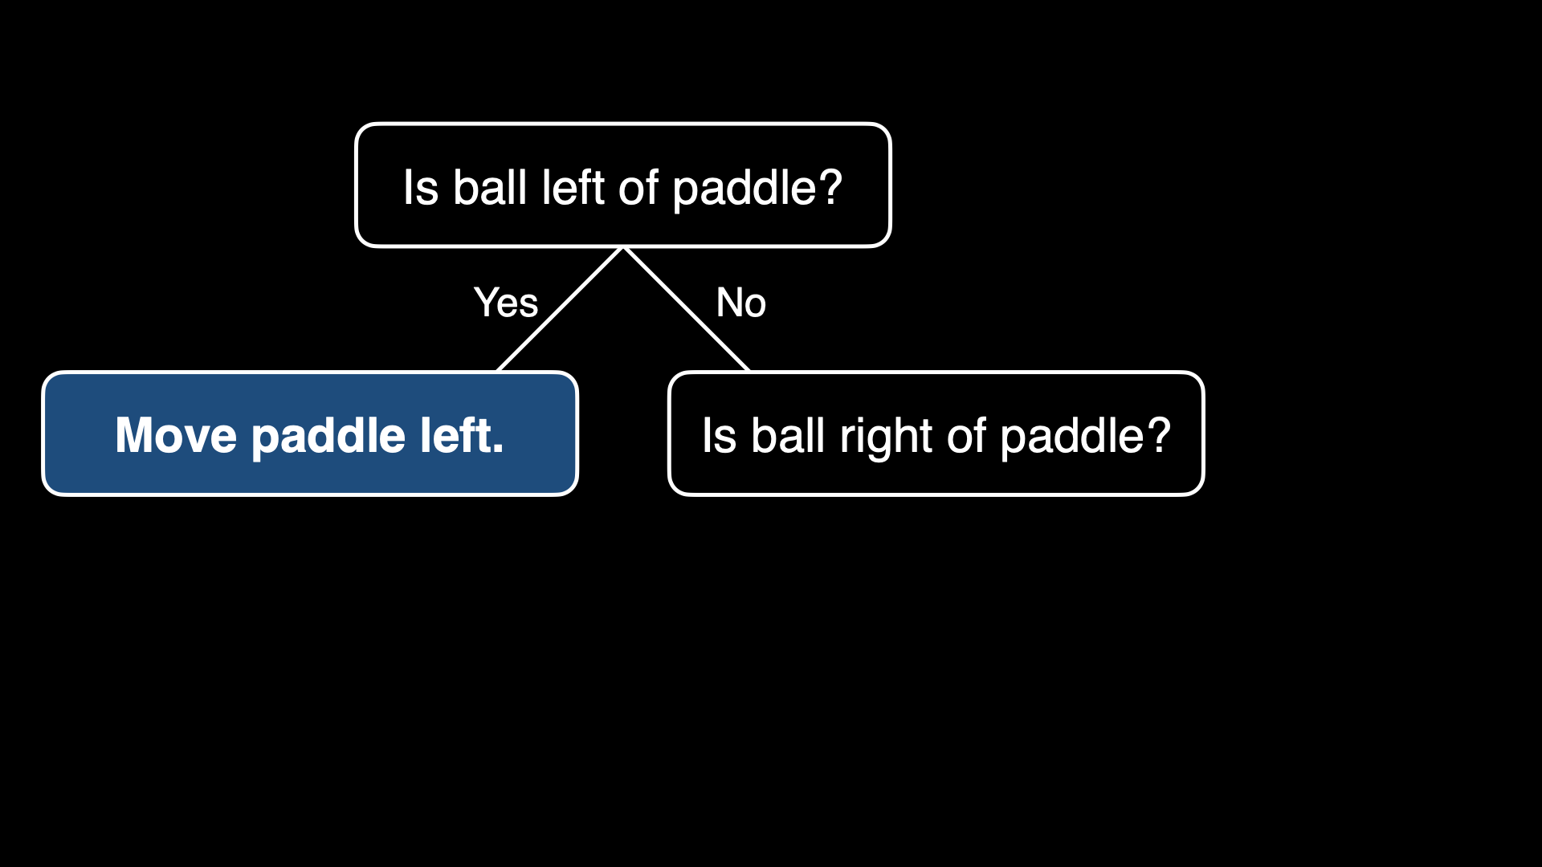

Slide 75
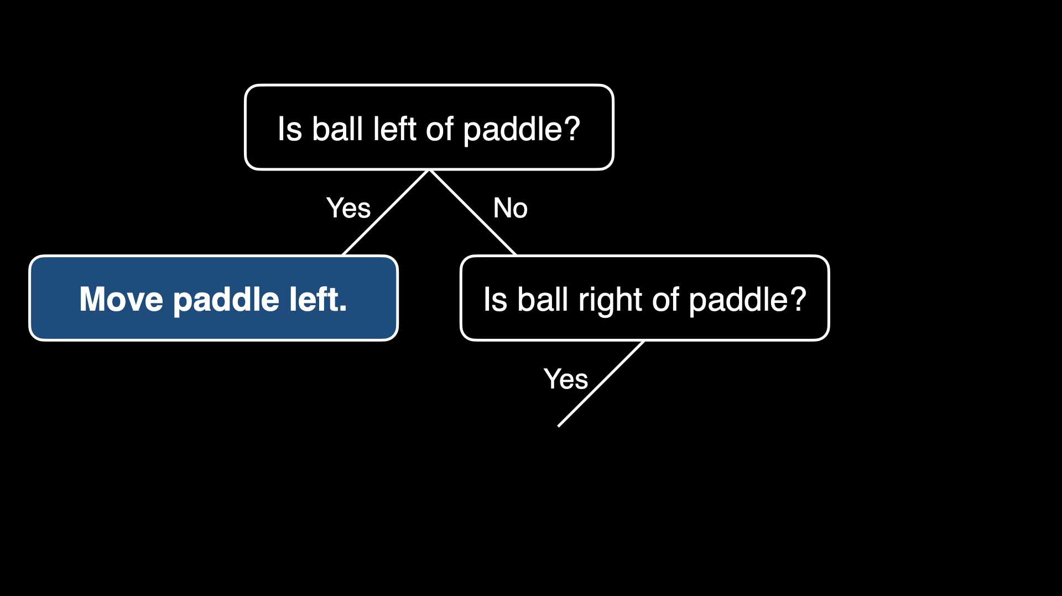

Slide 76
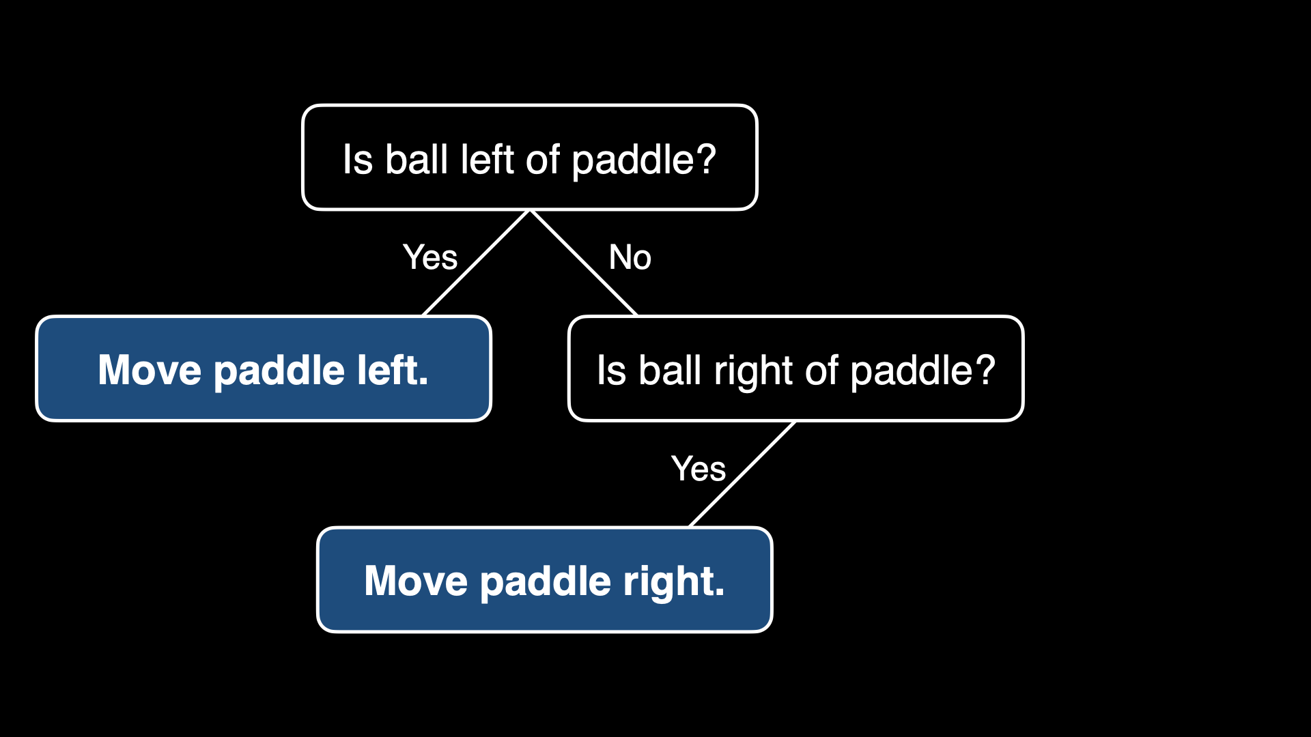

Slide 77
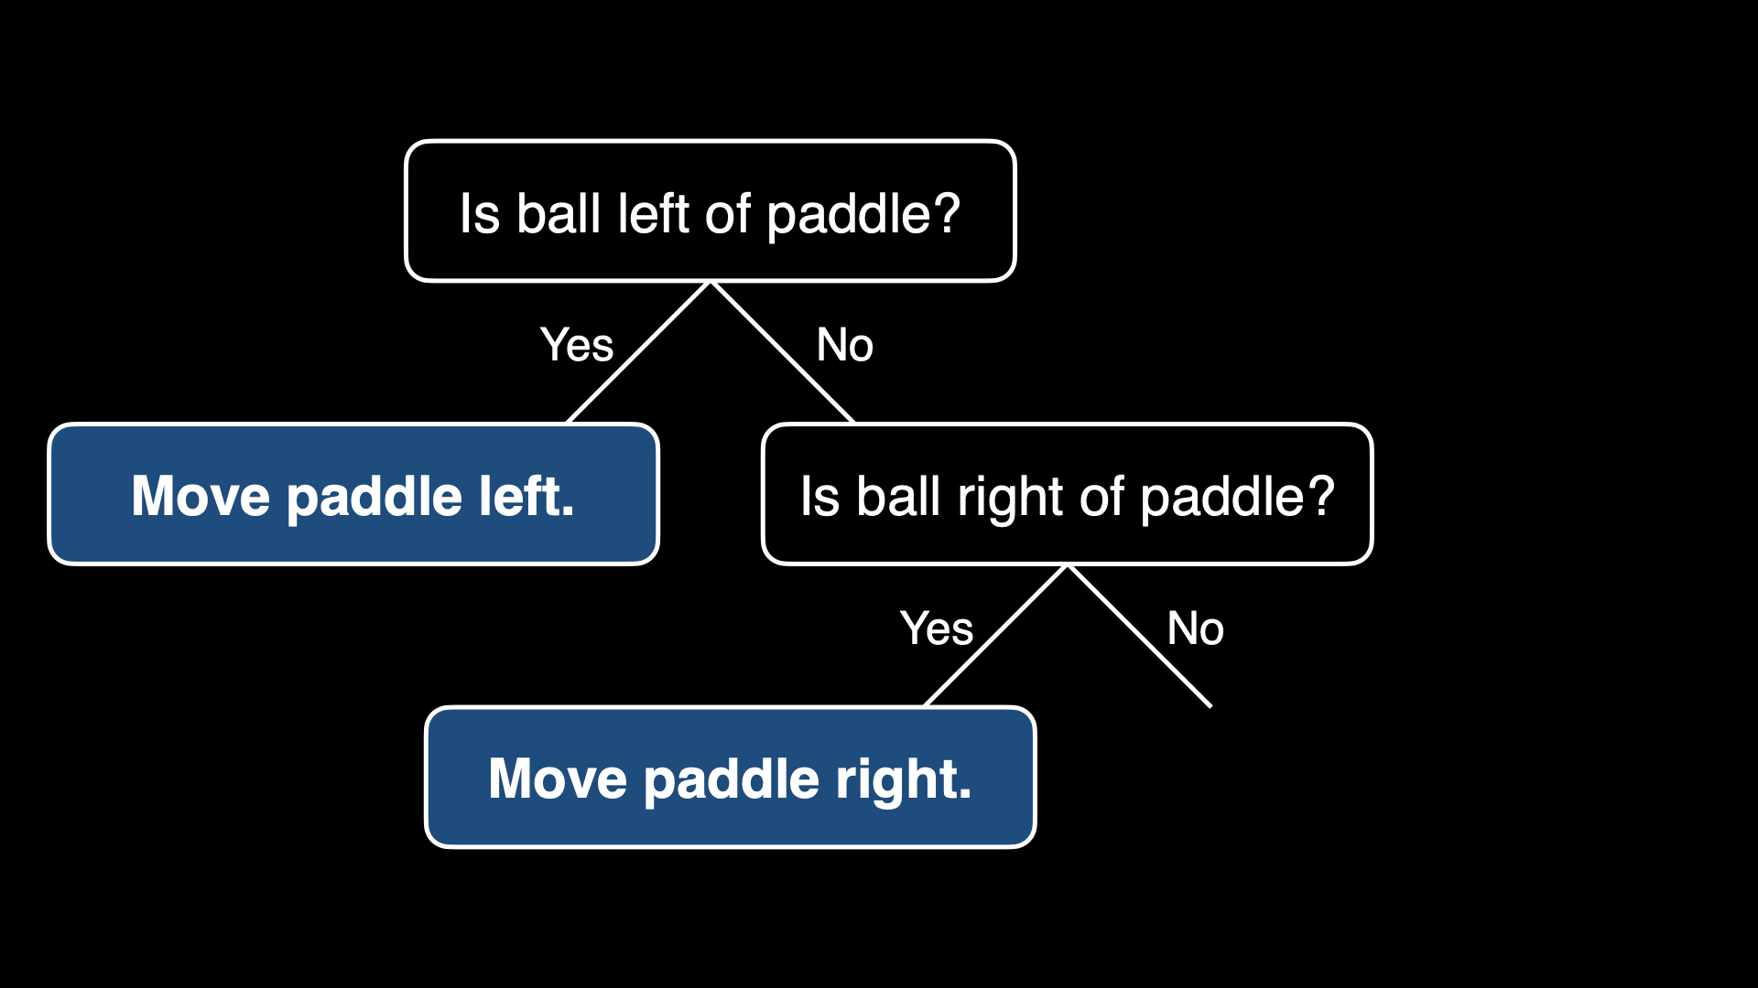

Slide 78
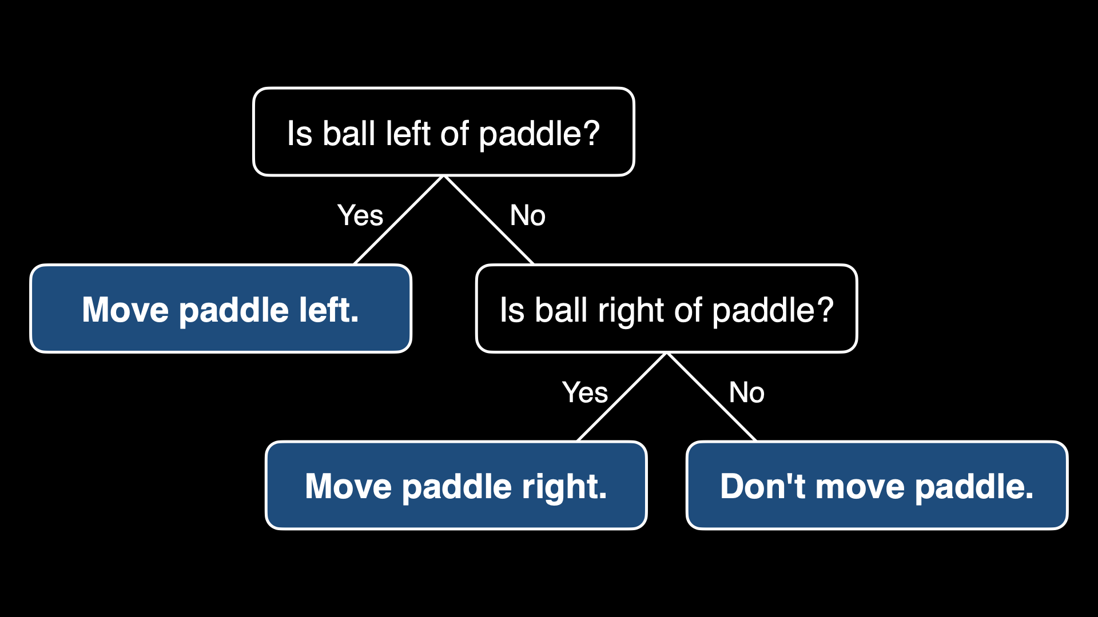

Slide 80
While game is ongoing:

Slide 81
While game is ongoing:
If ball is left of paddle:
Move paddle left

Slide 82
While game is ongoing:
If ball is left of paddle:
Move paddle left
Else if ball is right of padding:
Move paddle right

Slide 83
While game is ongoing:
If ball is left of paddle:
Move paddle left
Else if ball is right of padding:
Move paddle right
Else:
Don't move paddle

Slide 84

Notes:
X's turn

Slide 86
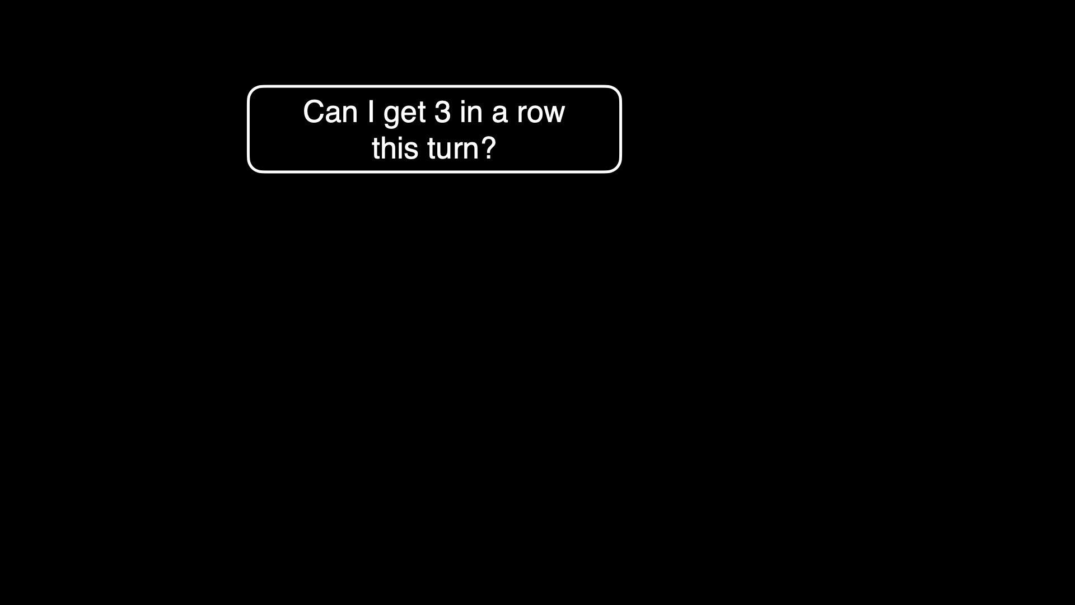

Slide 87
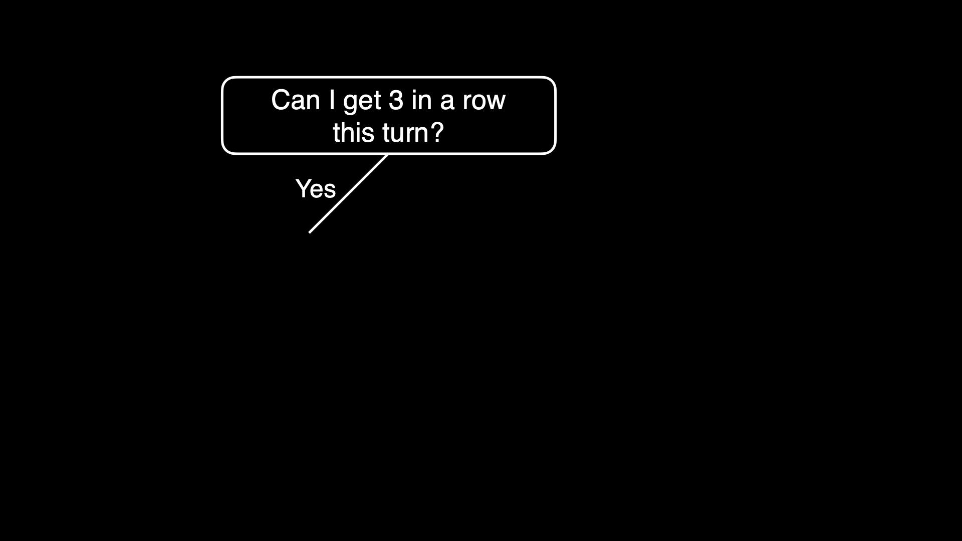

Slide 88
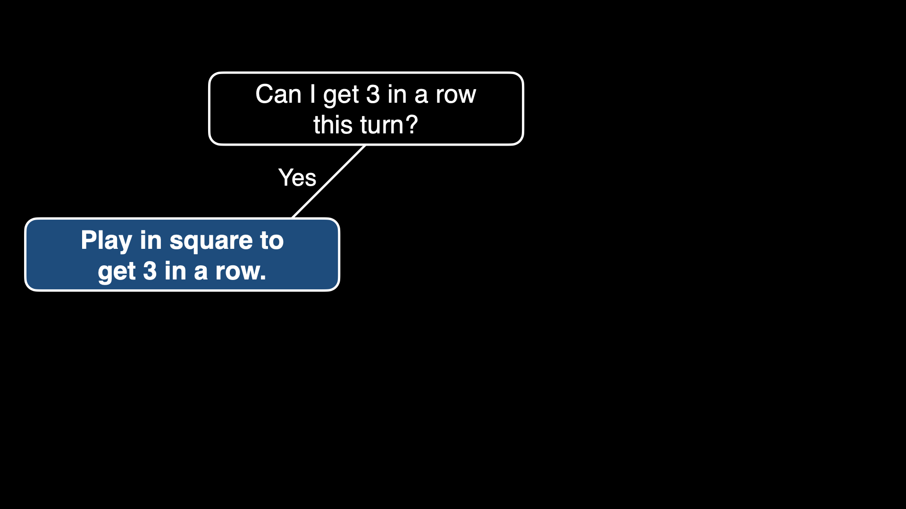

Slide 89
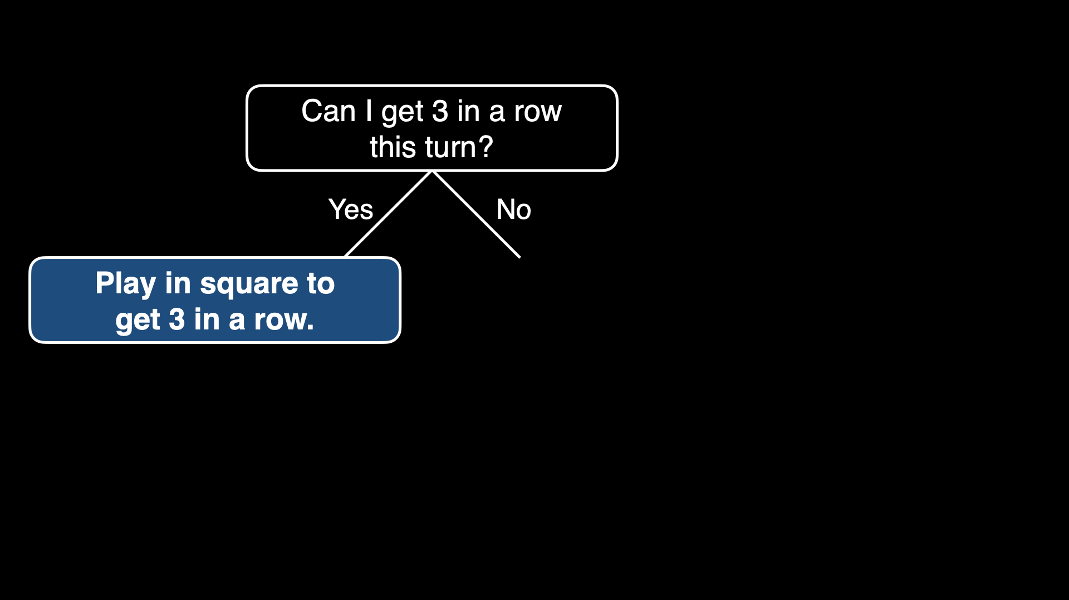

Slide 90
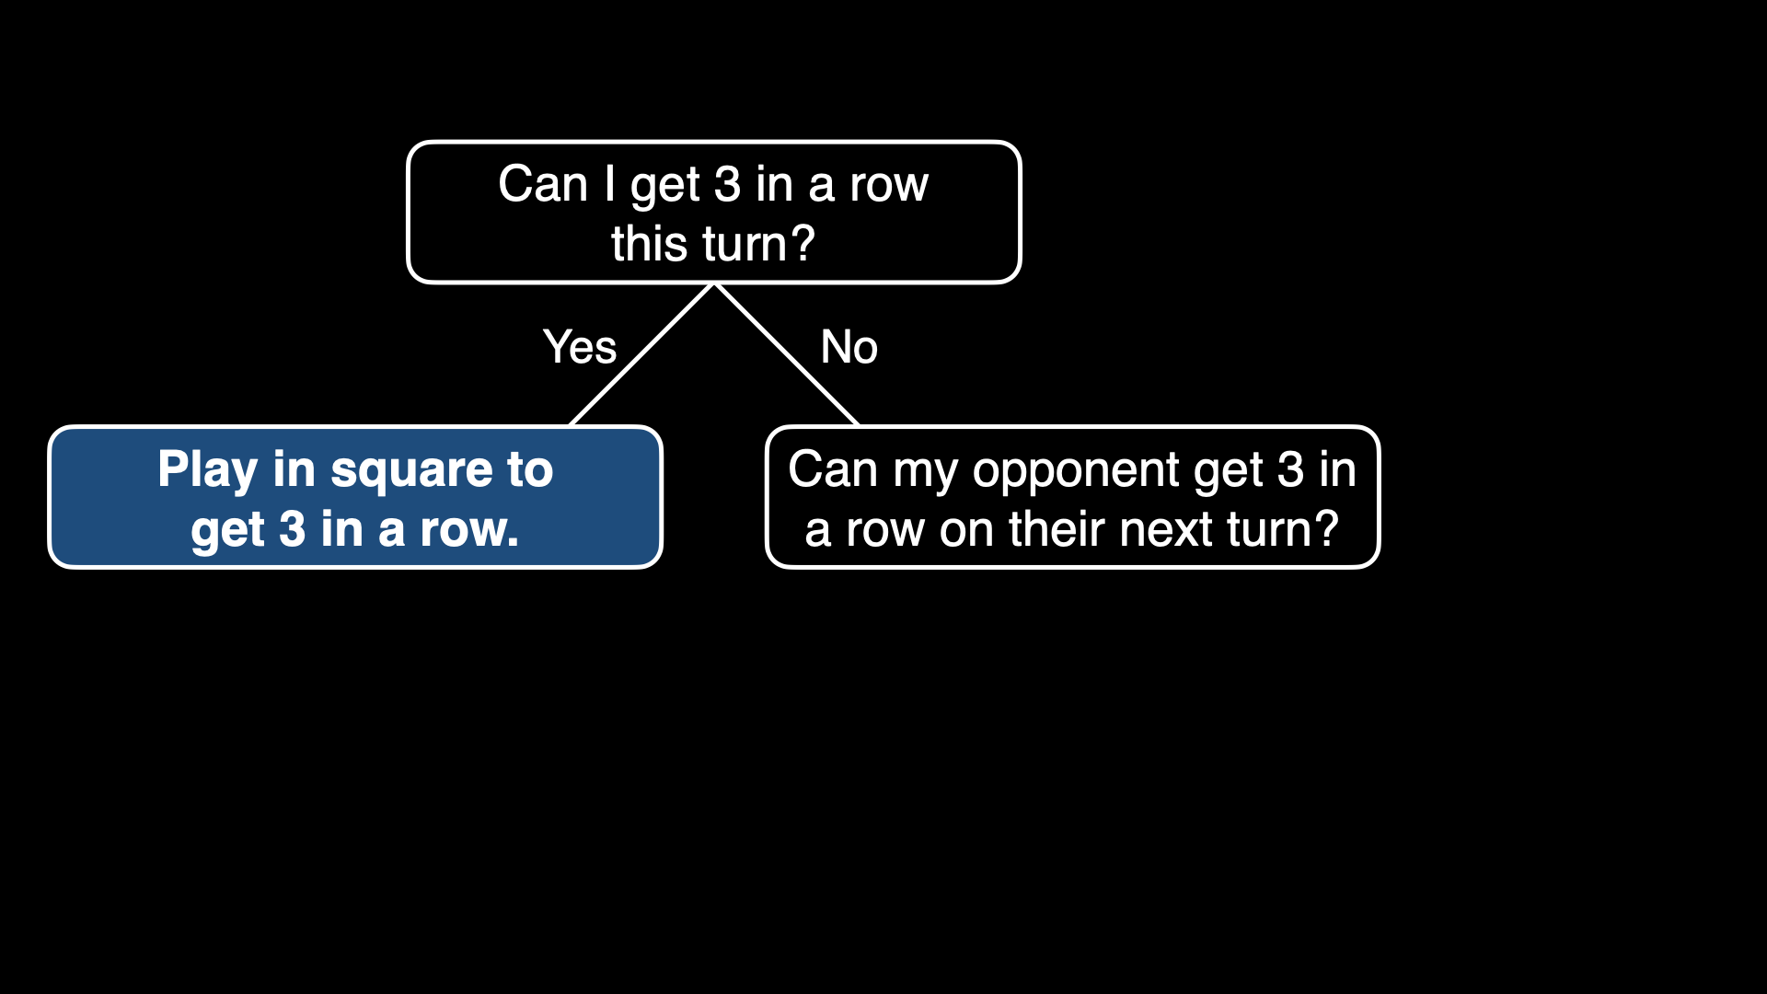

Slide 91
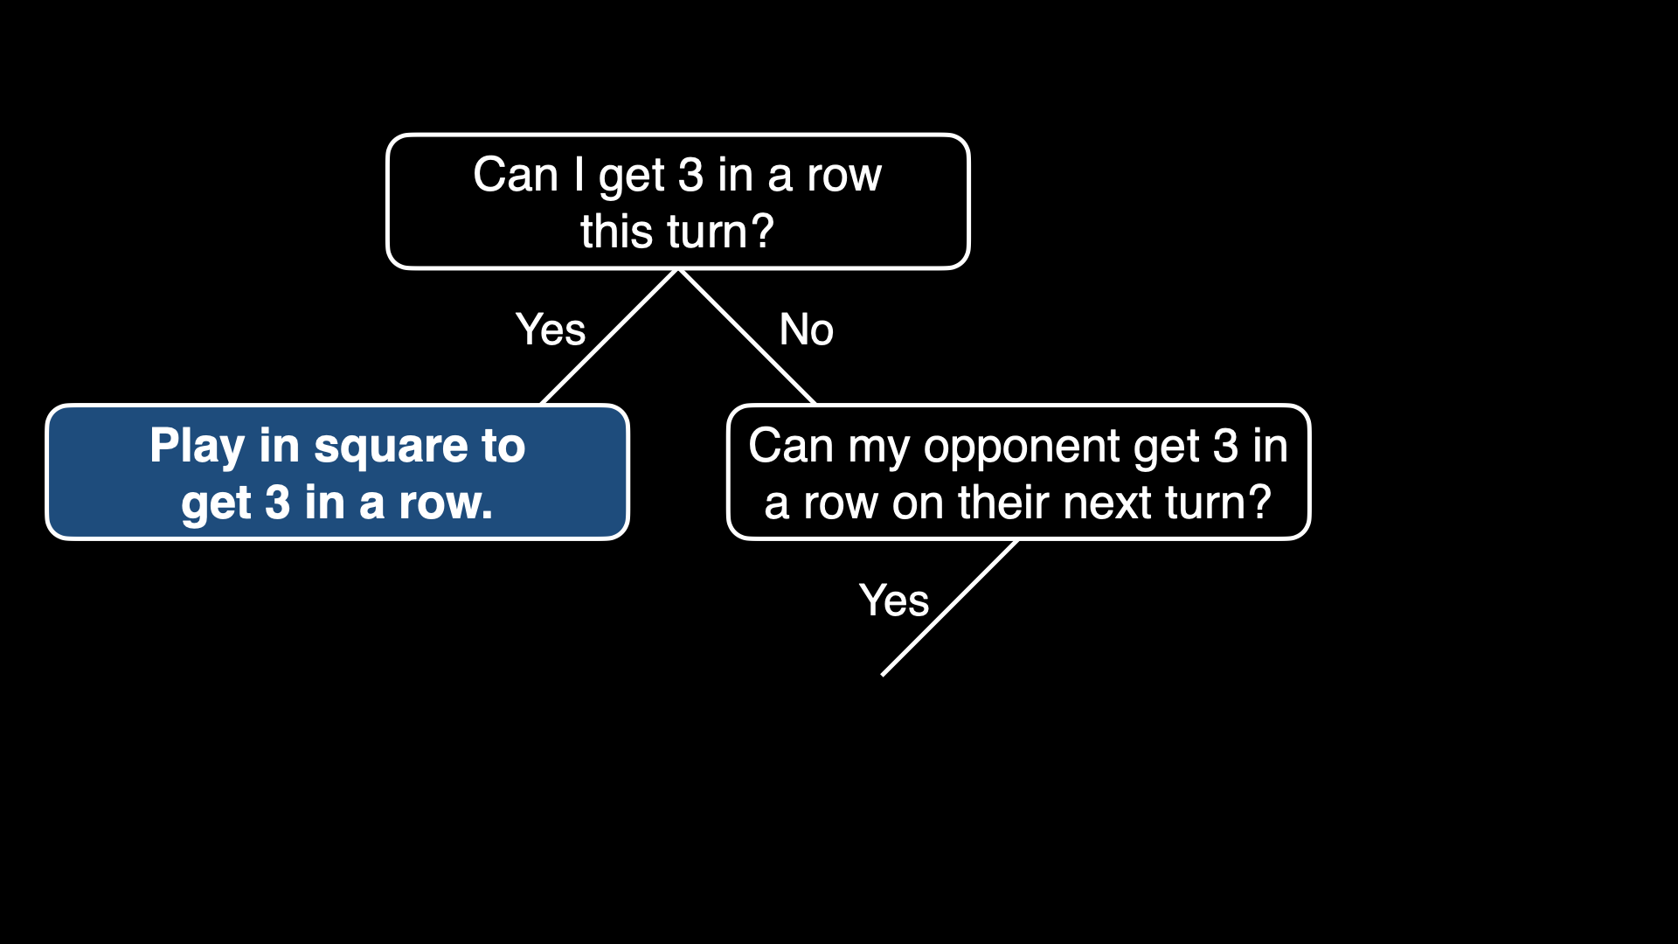

Slide 92
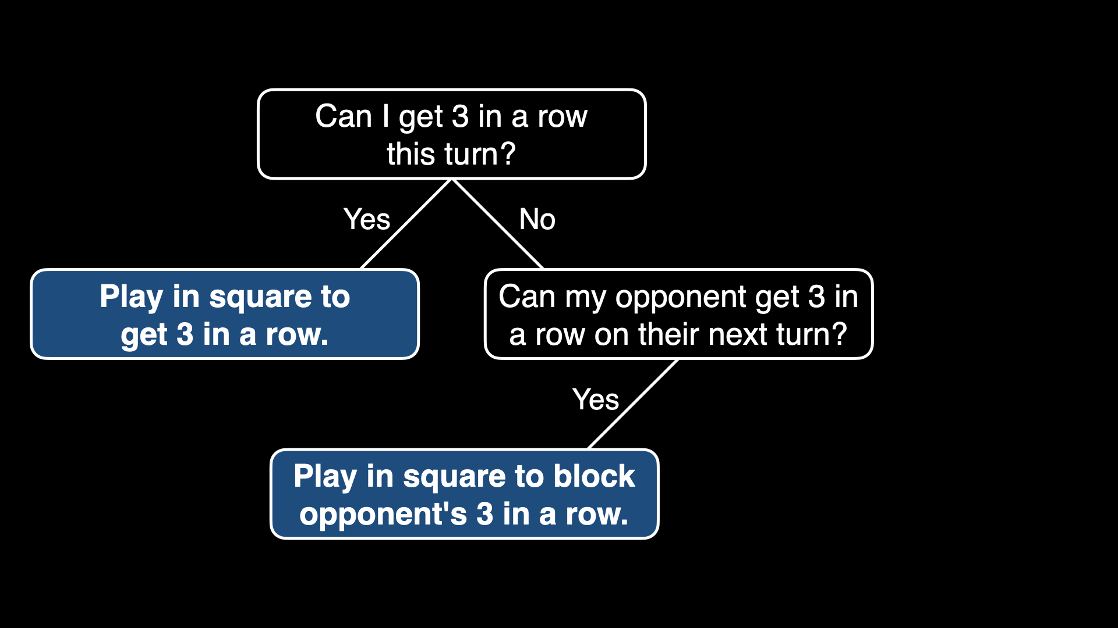

Slide 93
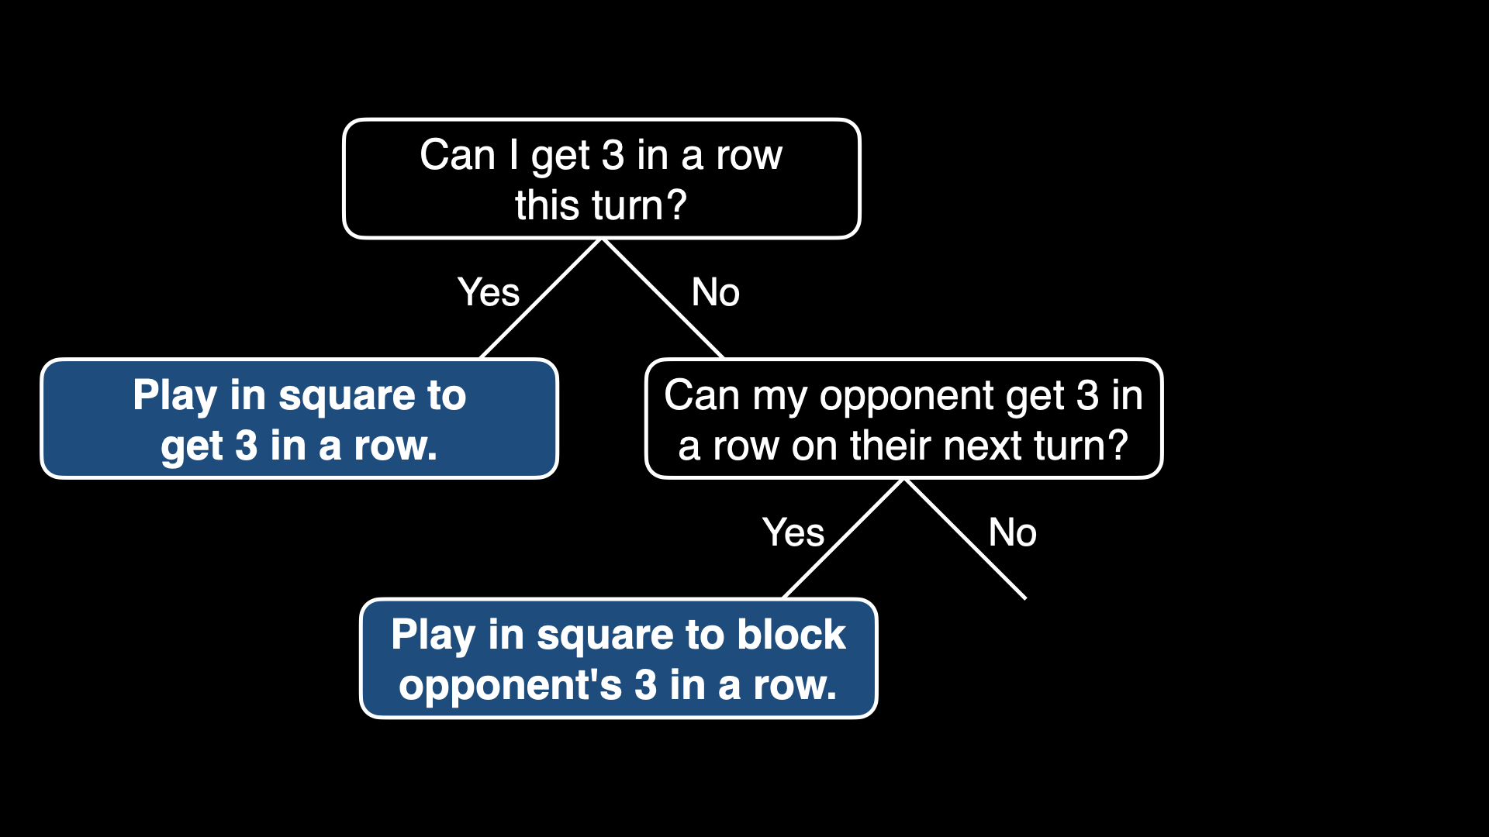

Slide 94
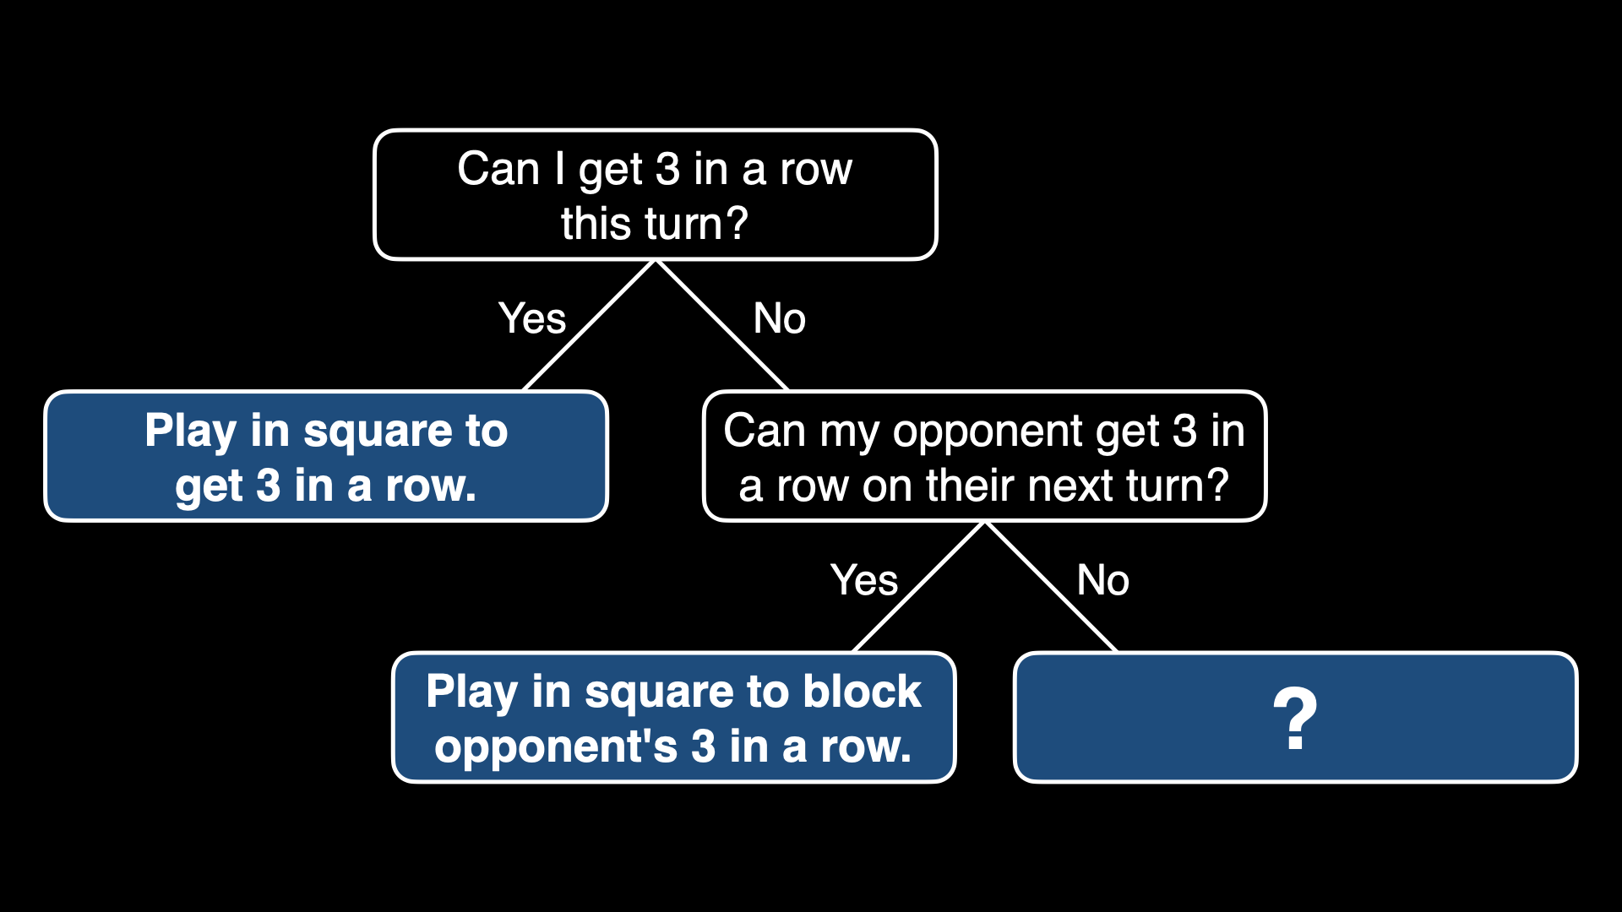

Slide 95
Notes:
O's turn

Slide 96


Slide 97
minimax

Slide 98
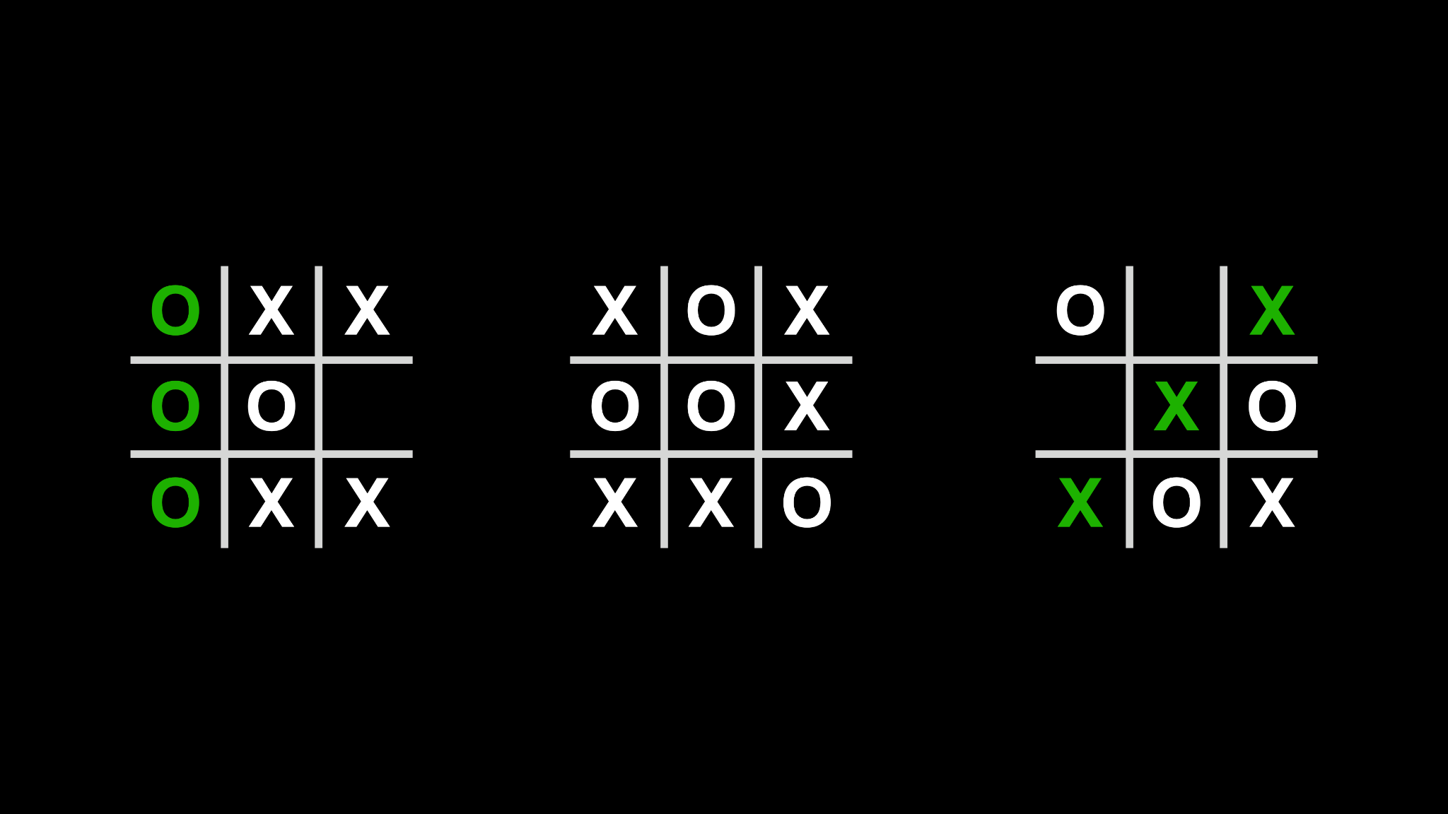

Slide 99
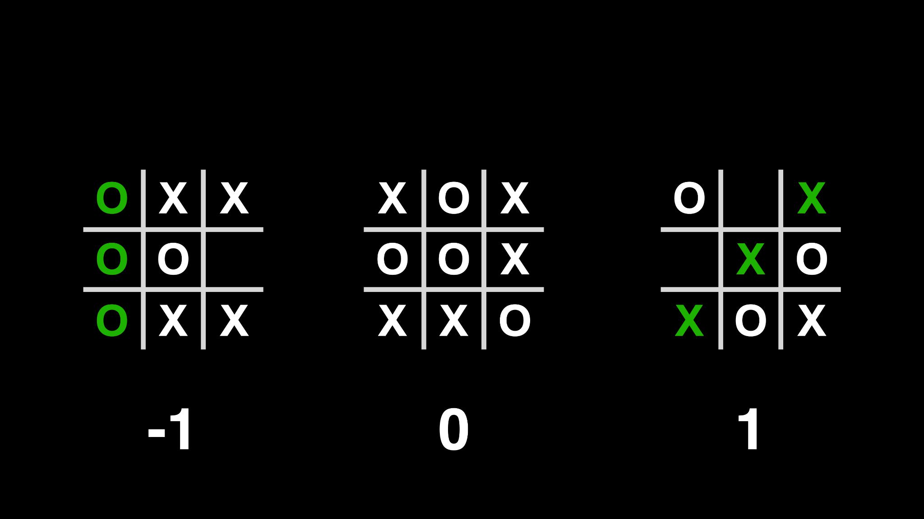

Slide 100
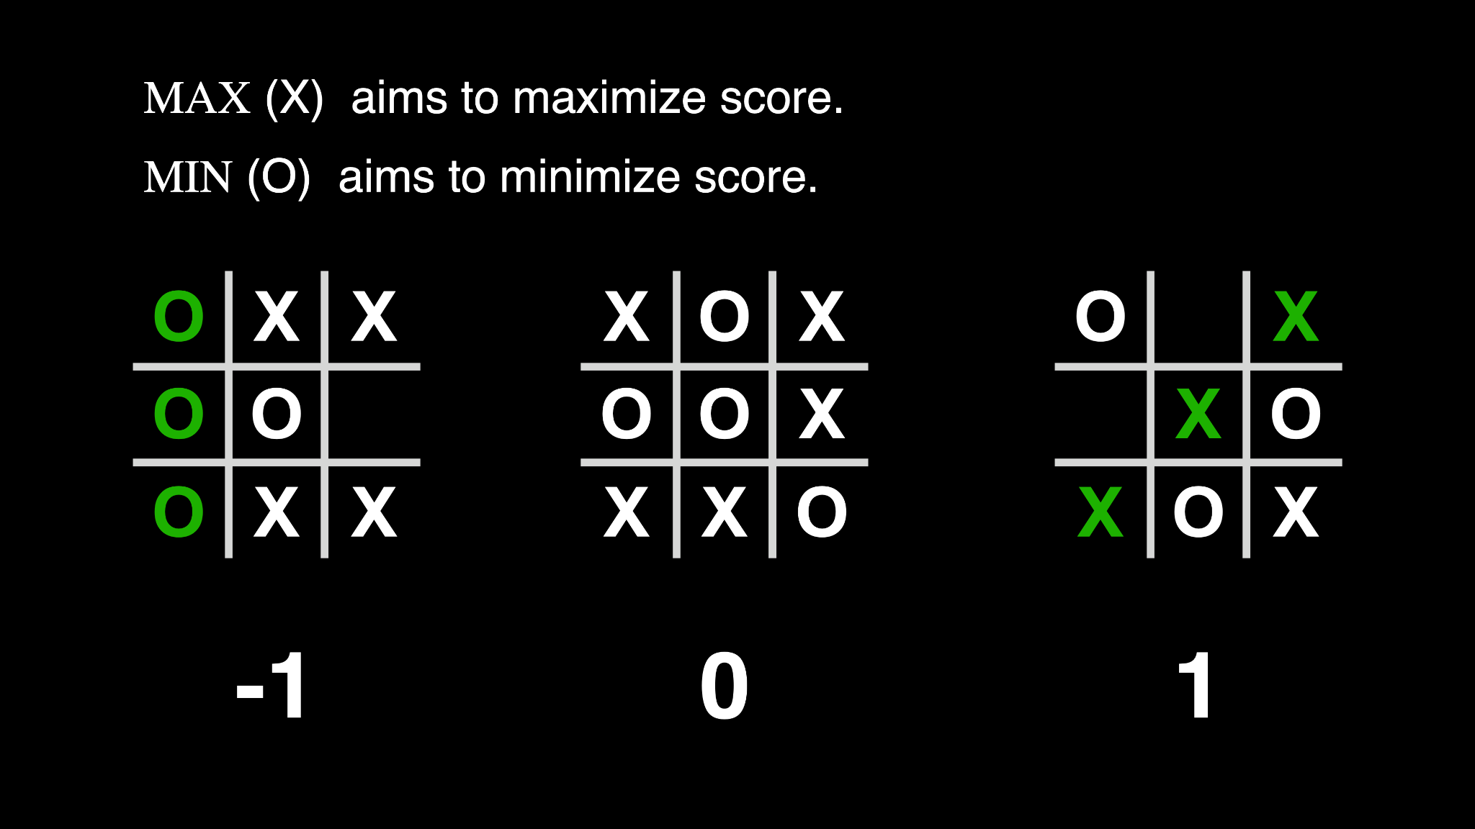

Slide 101


Slide 102


Slide 103


Slide 104
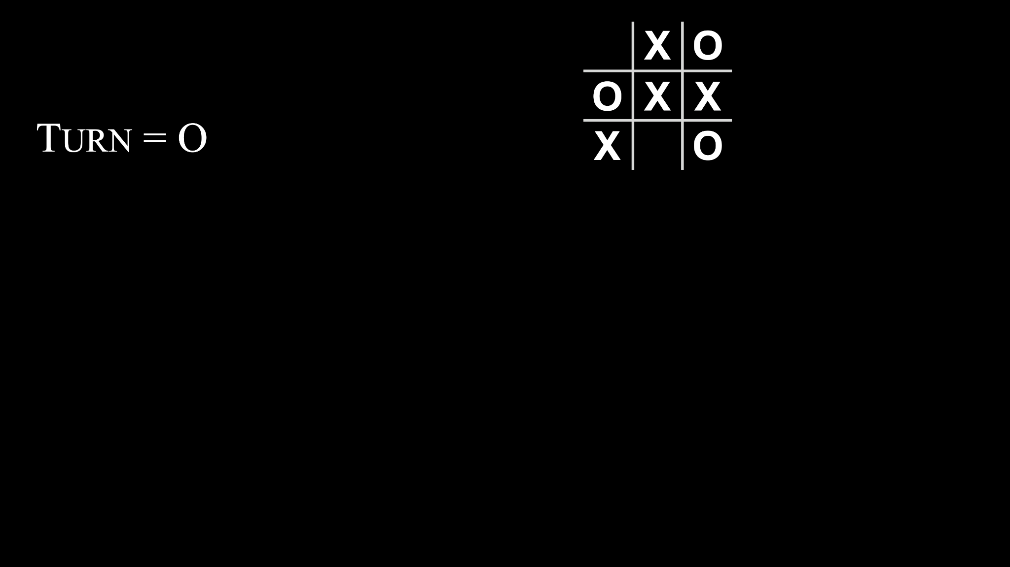

Slide 105
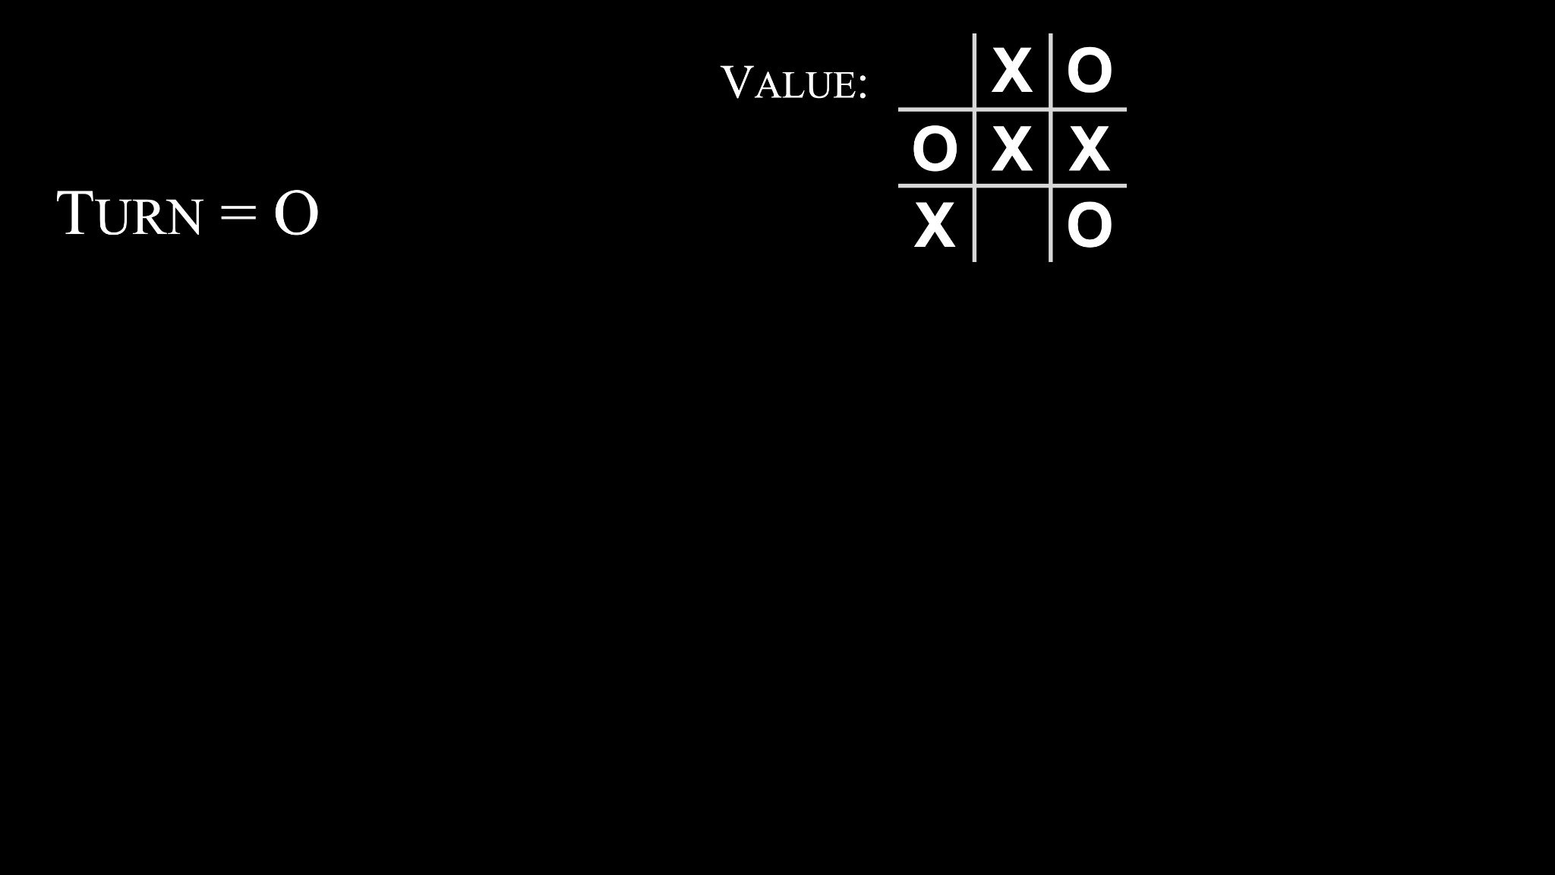

Slide 106
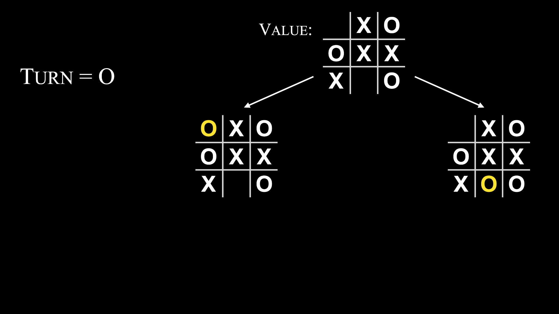

Slide 107
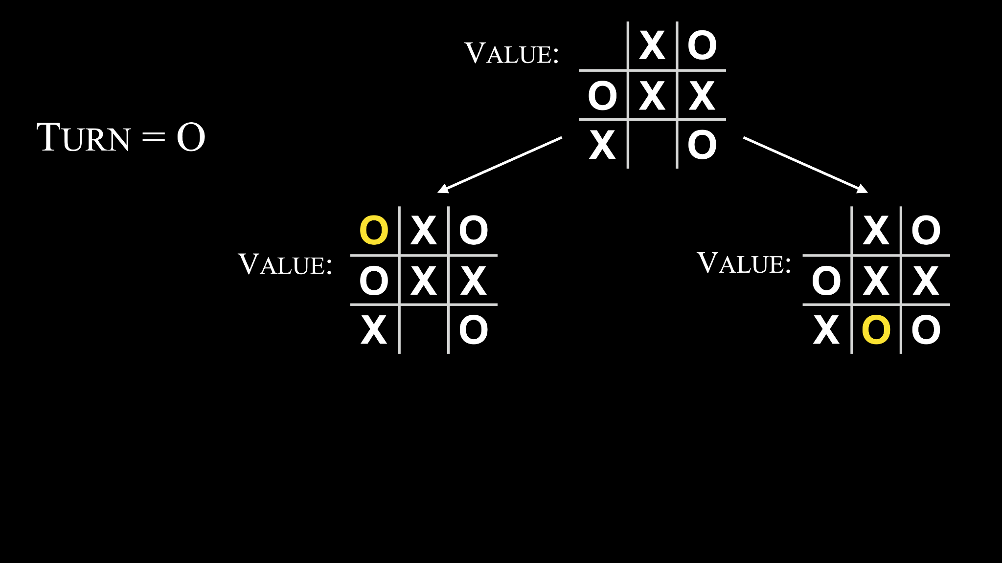

Slide 108
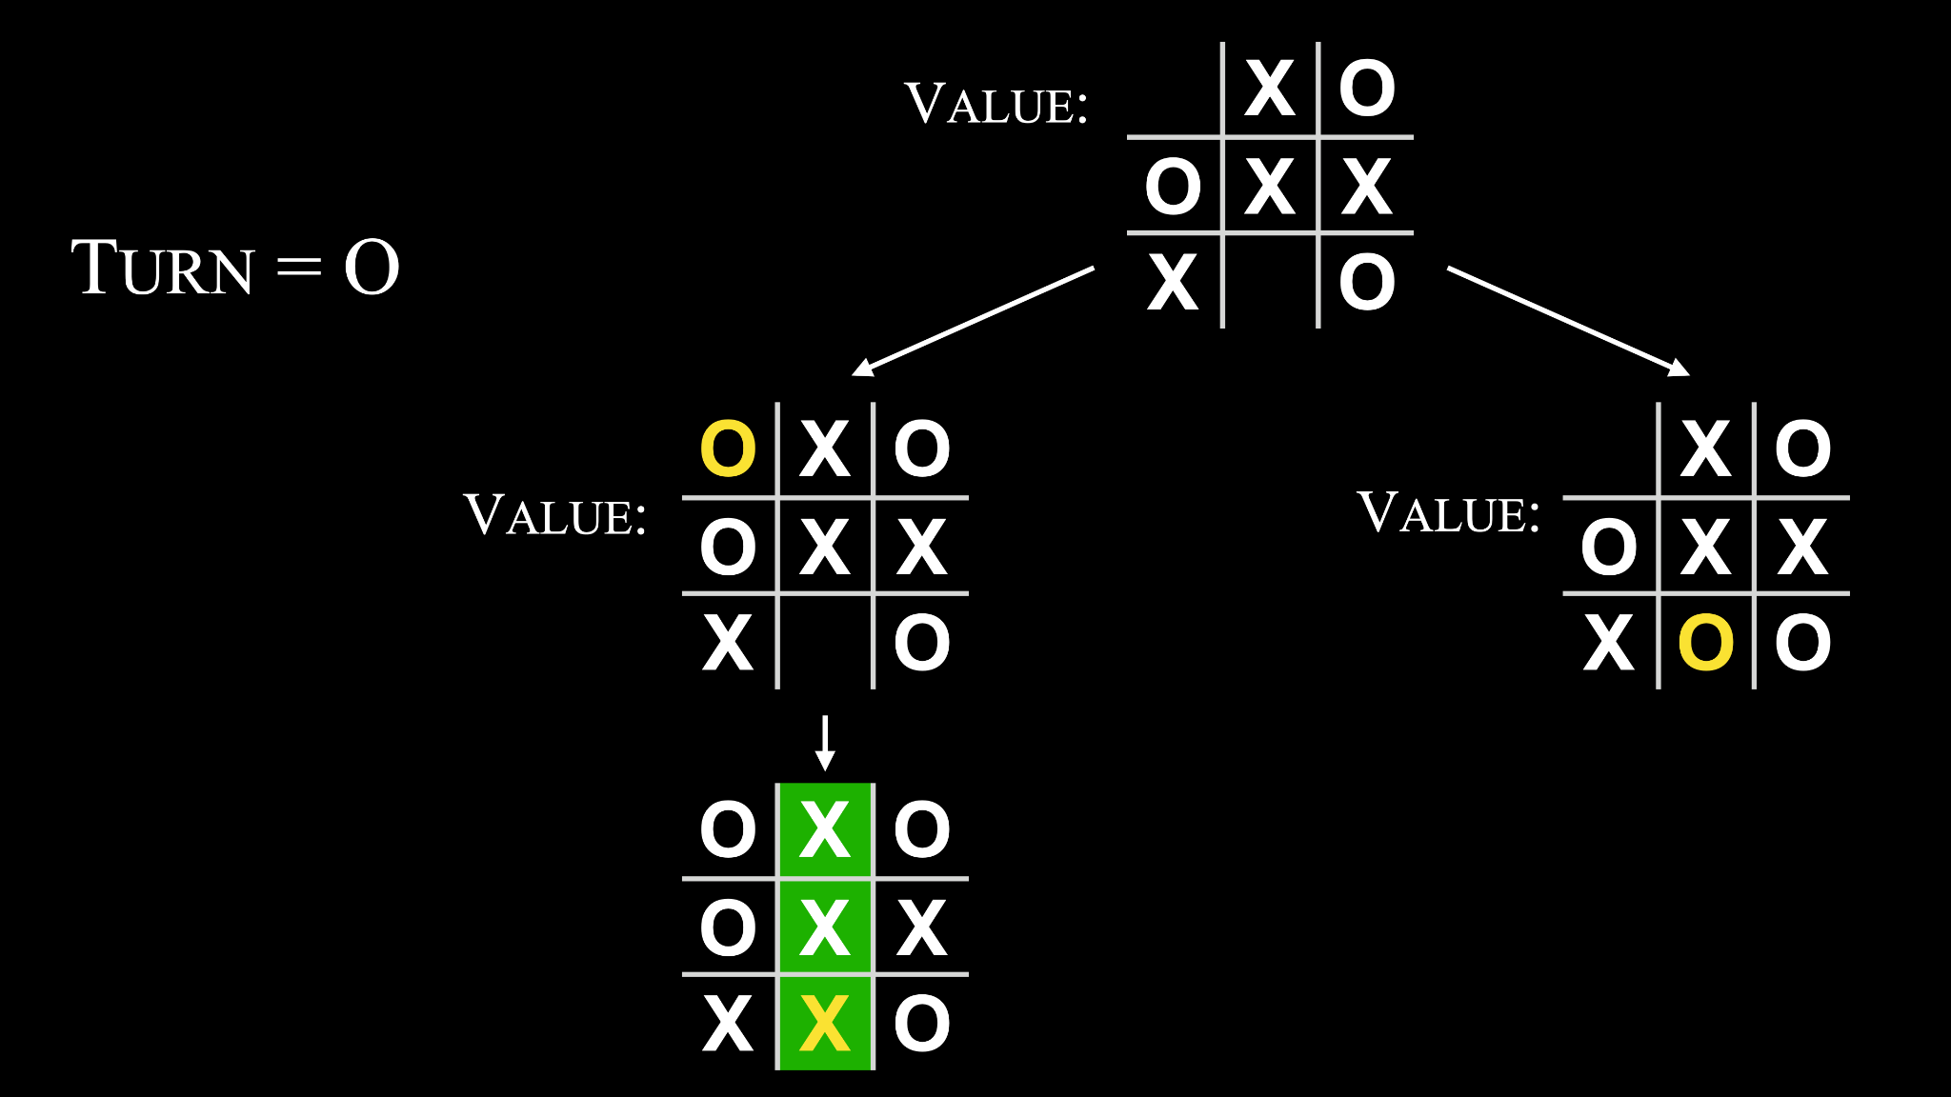

Slide 109
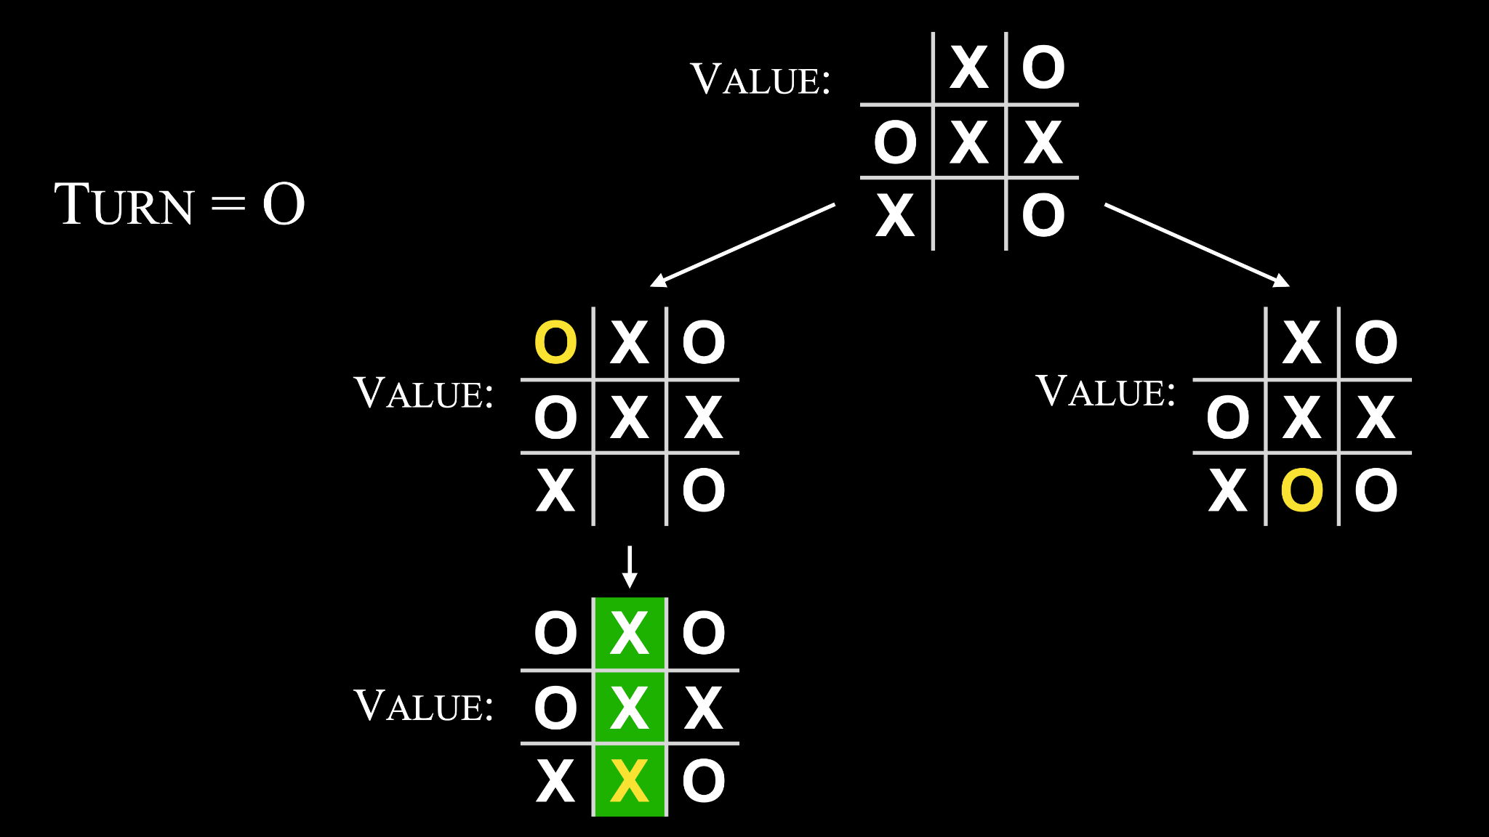

Slide 110


Slide 111


Slide 112
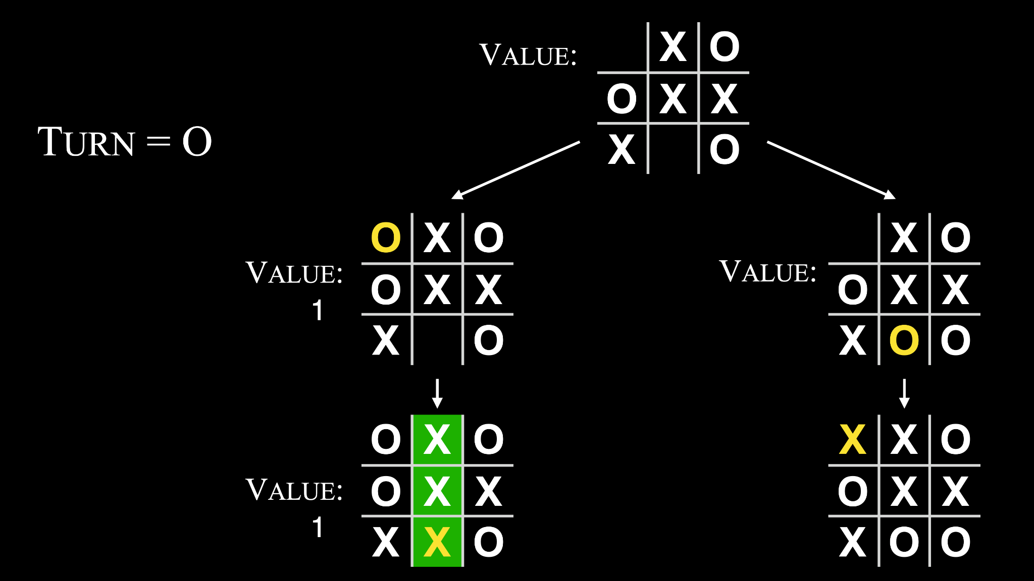

Slide 113
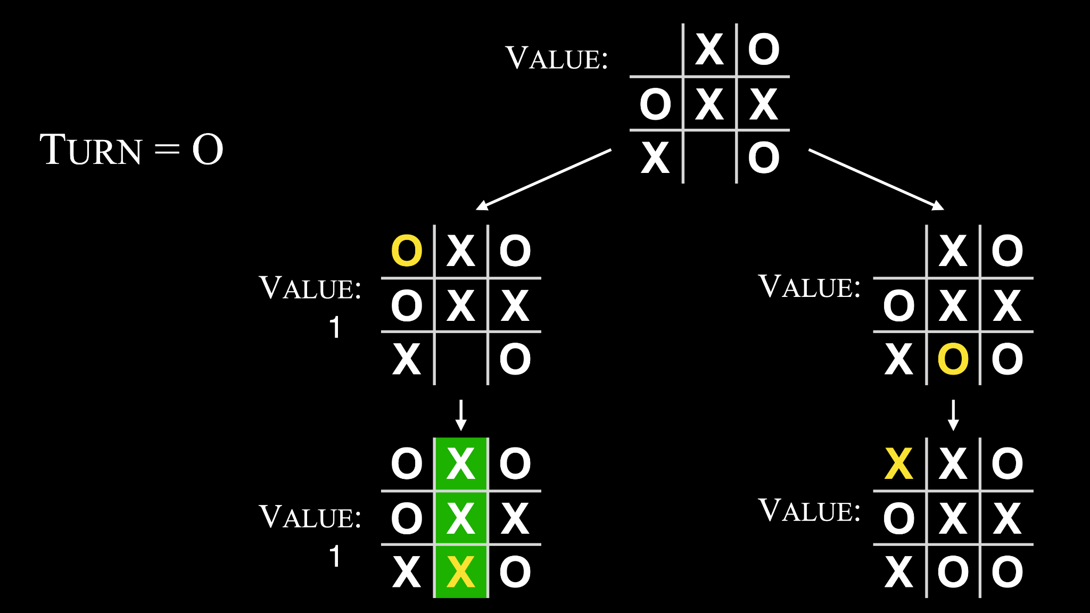

Slide 114


Slide 115


Slide 116


Slide 117
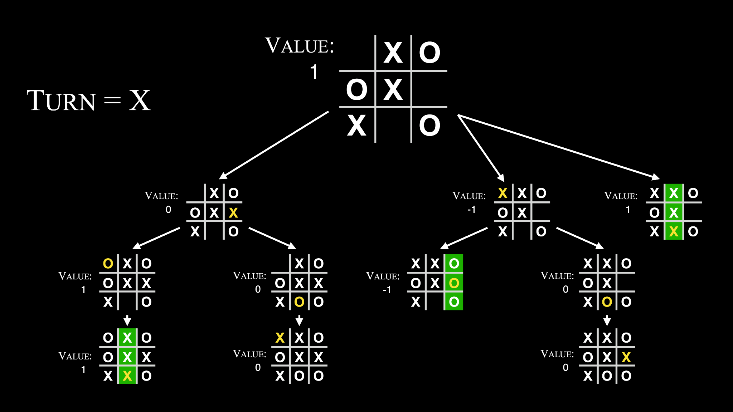

Slide 119
If player is X: For each possible move:
Calculate score for board
Choose move with highest score

Slide 120
If player is X: For each possible move:
Calculate score for board
Choose move with highest score
Else if player is O:
For each possible move:
Calculate score for board
Choose move with lowest score

Slide 121
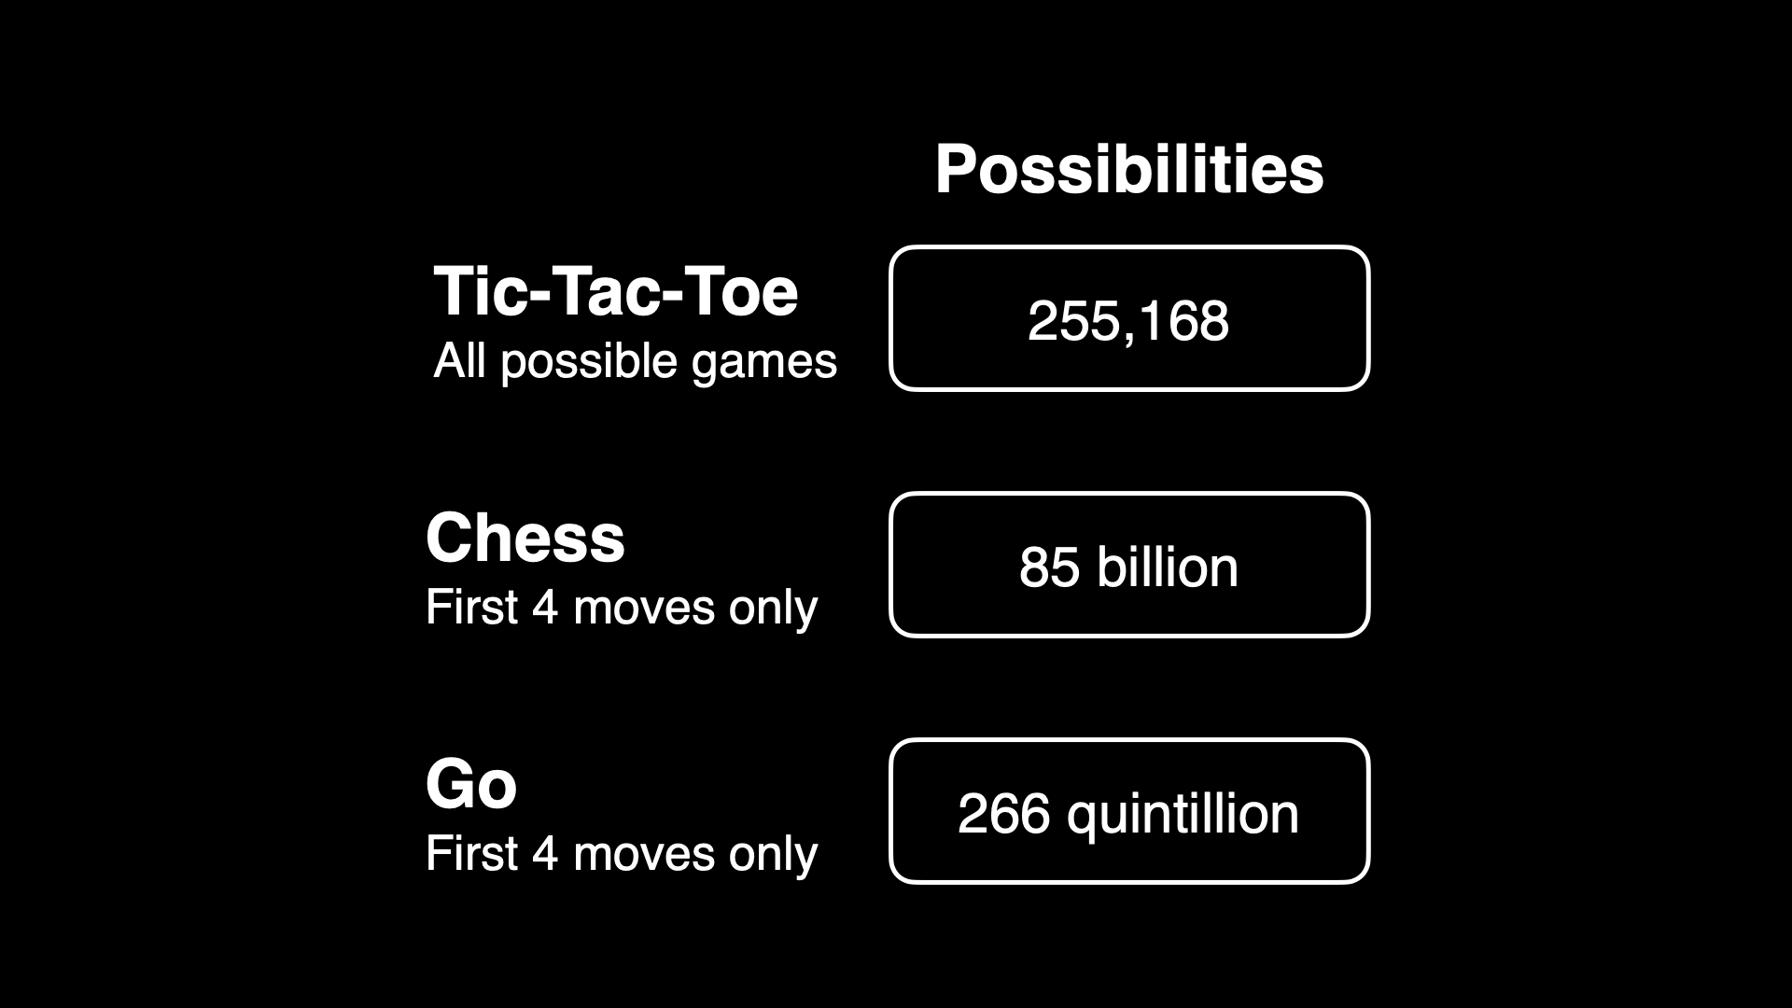

Slide 126
machine learning

Slide 127
reinforcement learning
Notes:
AI learns to make decisions by maximizing reward function

Slide 128

Notes:
https://emojipedia.org/google/15.0/pancakes

Slide 129
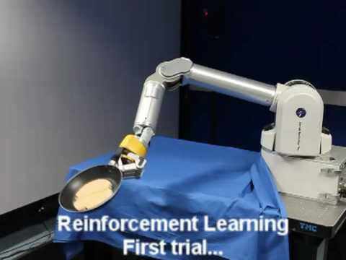
Notes:
https://www.youtube.com/watch?v=W_gxLKSsSIE

Slide 130
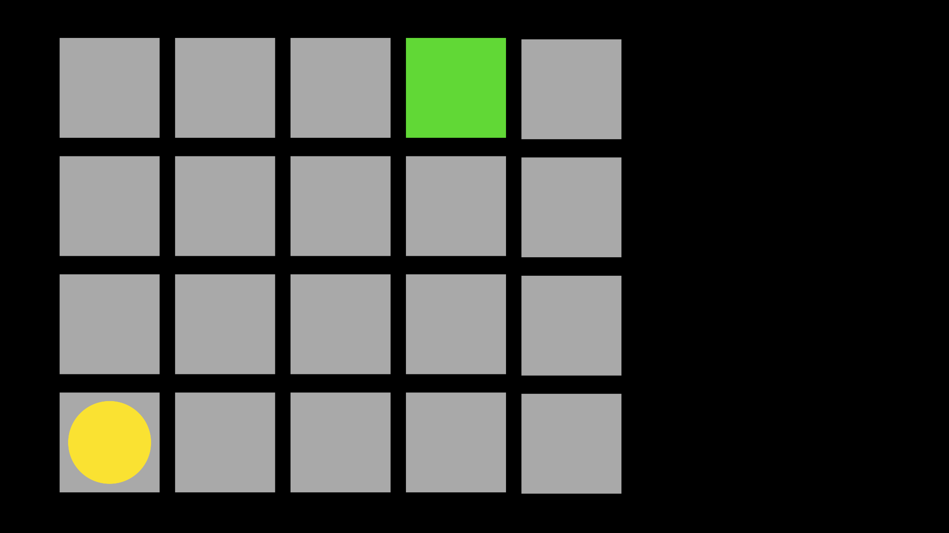

Slide 131
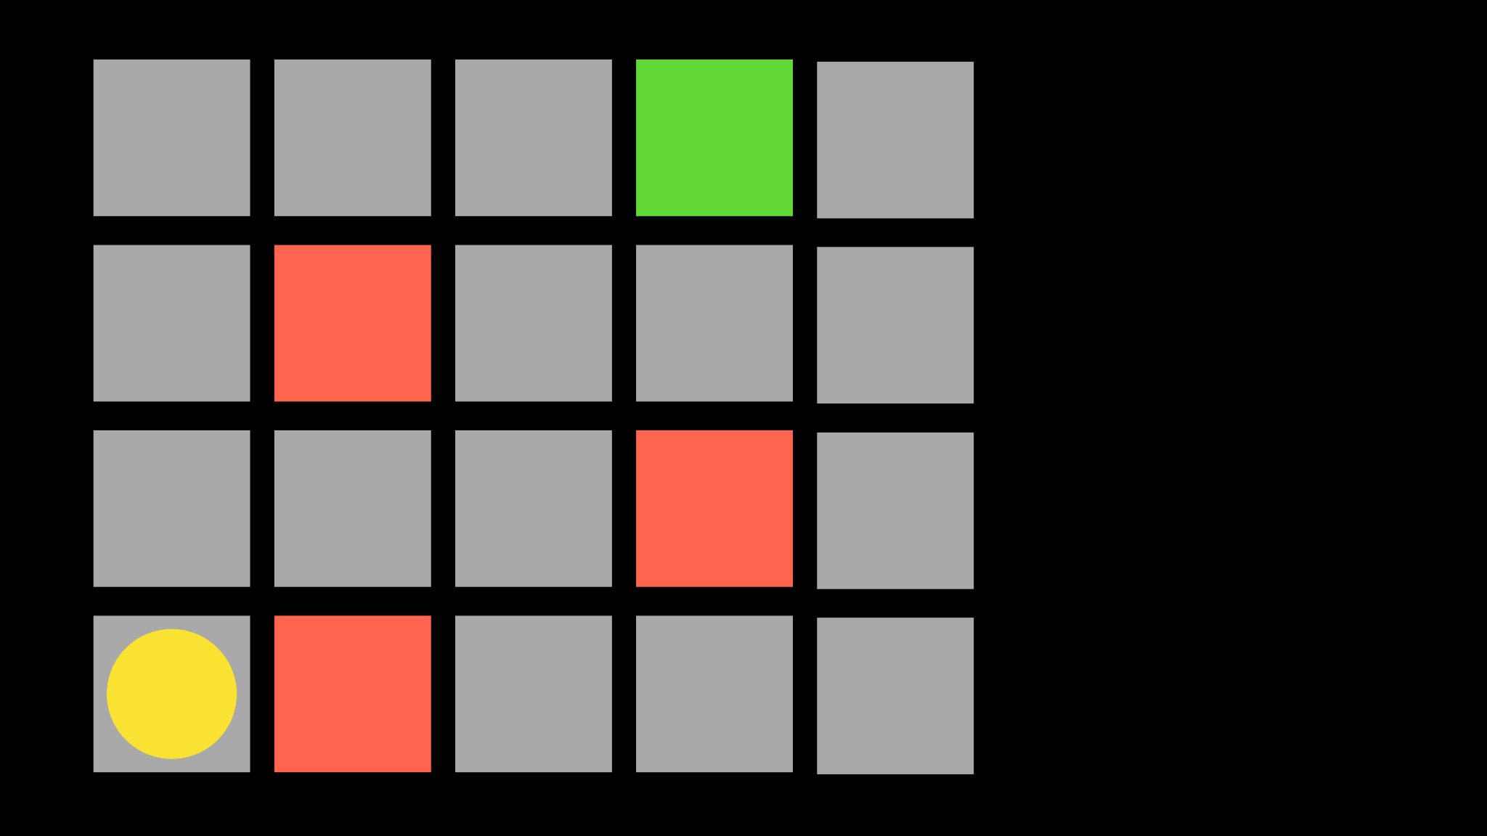

Slide 132


Slide 133


Slide 134


Slide 135


Slide 136


Slide 137


Slide 138


Slide 139


Slide 140


Slide 141


Slide 142


Slide 143


Slide 144


Slide 145


Slide 146


Slide 147


Slide 148


Slide 149


Slide 150


Slide 151


Slide 152


Slide 153


Slide 154


Slide 155


Slide 156


Slide 157


Slide 158


Slide 159


Slide 160


Slide 161


Slide 162


Slide 163


Slide 164


Slide 165


Slide 166


Slide 167


Slide 168
explore vs. exploit
Notes:
epsilon

Slide 169
epsilon = 0.10
If random() < epsilon:
Make a random move
Else:
Make the move with the highest value

Slide 170


Slide 171


Slide 172


Slide 173


Slide 174


Slide 175


Slide 176


Slide 177

Notes:
https://www.youtube.com/watch?v=Q70ulPJW3Gk

Slide 178
supervised learning
Notes:
labeled data

Slide 179


Slide 180
unsupervised learning
Notes:
unlabeled data, finding anomalies

Slide 181
deep learning
Notes:
inspired by the brain

Slide 182
neural networks

Slide 183


Slide 184


Slide 185


Slide 186


Slide 187


Slide 188


Slide 189


Slide 190


Slide 193


Slide 194


Slide 195


Slide 196
a
c
b

Slide 197
ax + by + c > 0
Notes:
if true, red; else blue

Slide 198


Slide 199


Slide 200


Slide 201
large language models
Notes:
neural network trained on lots of text

Slide 202

Notes:
2017
attention: weight of importance

Slide 203

Notes:
attention: weight of importance

Slide 204
Generative Pre-trained Transformers
Notes:
neural network trained on lots of text

Slide 205
Generative Pre-trained Transformers
Notes:
neural network trained on lots of text

Slide 206
"Massachusetts is a state in the New England region of the Northeastern United States. It borders on the Atlantic Ocean to the east. The state's capital is…"

Slide 207
"Massachusetts is a state in the New England region of the Northeastern United States. It borders on the Atlantic Ocean to the east. The state's capital is…"

Slide 208


Slide 211
[-0.0008102366, 0.013022771, -0.0055872737, -0.04236497, -0.02812971, 0.029492939, -0.009463957, 0.007963094, -0.003876683, -0.015795108, 0.0065605408, -0.0010248796, 0.014890658, -0.009182136, 0.00007839182, -0.010853401, 0.027605392, -0.022086935, -0.0042863074, -0.01765644, -0.00028120697, 0.03350398, -0.0017744919, -0.00441411, 0.0055610575, -0.0026461722, 0.002932909, -0.019045886, -0.010381515, -0.019150749, 0.022414634, -0.030751305, -0.037043132, -0.046769246, -0.0072421553, 0.000565691, -0.0049285977, -0.0035162137, 0.021182485, -0.030882385, 0.013959992, 0.011417044, -0.00638686, -0.02632081, -0.0018482242, 0.0048401193, -0.009221459, 0.0009232929, -0.01624078, -0.00077746663, 0.01895413, 0.02697621, -0.031223193, 0.0028509842, -0.0046074525, -0.011043468, 0.0075960704, 0.0036112466, -0.010840294, -0.00020972757, -0.004427218, 0.014916874, -0.03473613, 0.009201797, 0.010892726, -0.019609528, 0.006796484, 0.027605392, -0.0027936369, -0.0065834797, 0.020671275, 0.029912395, 0.023646783, -0.012006903, 0.008159713, -0.009326323, -0.0046140067, -0.0075305304, -0.0075501925, 0.013147297, 0.022558821, -0.01624078, -0.032507773, 0.013527429, 0.016332535, 0.0017302524, -0.010591242, 0.021326672, 0.008343225, -0.014746469, 0.0090969335, 0.027815118, -0.0003426506, 0.010329083, -0.0028755616, -0.0029607634, -0.0034768898, 0.03292723, -0.019897902, -0.018639538, 0.0051809265, 0.015375652, -0.017197661, -0.015467408, -0.020553302, -0.0037161105, -0.0100275995, -0.0108730635, -0.00039262476, -0.020487761, -0.011050021, -0.010453609, 0.010787862, -0.045563314, -0.012603316, 0.0052497433, -0.008146605, -0.011980687, 0.0032245615, -0.013435672, 0.03588963, -0.003170491, -0.0056691985, 0.01565092, 0.041866865, -0.012786828, -0.005374269, -0.0041224575, -0.0018613322, -0.0005124398, 0.017813735, -0.009306661, 0.001985858, 0.009739224, -0.011122115, 0.029545372, -0.038956895, -0.00983098, -0.0190721, -0.02561298, -0.009339431, 0.023659892, -0.0054693017, 0.013376687, 0.004427218, 0.009994829, 0.0066031413, 0.0038144202, 0.015428084, -0.02586203, 0.008022079, -0.02392205, 0.021772344, 0.015113493, 0.015270789, -0.0065113856, 0.017695764, 0.018927913, -0.0053054523, -0.0056462595, -0.024459478, 0.010040708, 0.015782, -0.00989652, 0.0025036228, 0.014785794, -0.0015672221, -0.0041257343, 0.011829946, -0.0038242512, -0.0038013123, 0.01700104, -0.032507773, 0.002025182, 0.008310455, 0.013724048, 0.00044485184, 0.030987248, -0.024367722, -0.012000349, 0.010256989, 0.017053474, 0.0008806919, 0.02224423, -0.0049974145, 0.011764406, 0.030672656, -0.0067080054, 0.017708872, -0.023463272, 0.014864442, 0.035339095, 0.010427393, -0.010119355, -0.6820341, -0.020881, 0.004047087, -0.005246466, -0.016149024, -0.0056724753, 0.010499487, 0.012426359, -0.023620568, 0.004391171, -0.013658508, 0.030934816, -0.0006754702, -0.024328398, -0.0019022946, -0.01642429, -0.0003072181, -0.03258642, 0.003457228, 0.006717836, -0.005400485, -0.0015205248, 0.00082580233, 0.016463615, 0.021169377, 0.007366681, 0.011731636, 0.012747504, -0.041499842, -0.008690586, -0.023686107, 0.006881686, 0.011561233, 0.013474996, 0.03549639, -0.0065572634, -0.025980003, 0.019779932, 0.012852368, 0.022086935, -0.0037652652, 0.0030459652, 0.02288652, 0.006816146, -0.008769234, -0.004725424, 0.019832363, -0.0042011053, 0.016948609, -0.017079689, 0.0050629545, 0.008212145, -0.013566752, 0.005308729, -0.01953088, -0.0076943804, 0.02198207, 0.003496552, 0.008605384, 0.012511561, -0.011849607, -0.0015090554, -0.030436713, -0.04690033, -0.01066989, -0.0037193873, -0.0037226644, 0.0045779594, -0.008657816, 0.00086840324, 0.020749921, 0.004070026, -0.013894452, -0.010945157, 0.025141092, 0.0060788225, 0.0069210096, -0.0056102127, -0.0075633004, -0.015375652, 0.0027887214, -0.006458954, -0.015323221, -0.00082457345, 0.025796492, -0.022388417, -0.009293553, 0.002854261, 0.009739224, 0.013842019, 0.019543989, 0.007877892, -0.017079689, -0.007812352, -0.011502246, -0.003434289, -0.008913422, 0.026268378, 0.017564684, -0.008906867, -0.00344412, -0.0051317713, 0.003362195, 0.0052300813, 0.009214905, -0.0056233206, 0.0015418254, 0.0082318075, 0.0333729, -0.023882726, 0.00996206, -0.005892034, -0.03187859, -0.007812352, 0.004525528, -0.029309427, 0.011030359, -0.02036979, 0.008670924, -0.015532948, 0.005357884, -0.0060558836, 0.0027100735, 0.000044265013, 0.0024036746, 0.023437057, 0.019281829, -0.03279615, 0.0154805165, -0.0023037263, -0.011331843, 0.015519841, 0.02288652, 0.0022938952, 0.019242505, 0.01597862, 0.008434981, -0.0028673692, 0.022086935, -0.032298047, -0.016201455, 0.009909628, -0.0046402225, -0.0040307017, -0.02063195, -0.021103837, -0.007327357, -0.016699558, -0.025377035, 0.022545714, 0.020658165, 0.0060362215, -0.012917908, 0.004892551, -0.0141828265, -0.020933433, -0.012301832, -0.007936878, 0.0218641, -0.017839951, 0.0020972758, 0.008546399, -0.02541636, -0.004092965, 0.0056462595, -0.005823217, 0.01565092, 0.026294595, -0.02521974, -0.0044763726, 0.02224423, -0.020186279, 0.0009855557, 0.023555027, 0.021116944, 0.025403252, -0.0016409544, -0.012151091, -0.007392897, -0.01196758, 0.00060337636, -0.008205591, -0.0021382382, 0.018573998, 0.021641264, -0.008815112, 0.020343574, 0.004437049, -0.019255612, 0.010211111, -0.0046762694, 0.006504832, 0.000019175532, 0.030751305, 0.021497076, 0.005413593, -0.0030394113, 0.008041741, 0.017459821, 0.004404279, 0.018521566, -0.0025904633, 0.022034504, 0.005400485, -0.00090445013, -0.02878511, -0.0033195943, -0.031511568, 0.009352539, 0.0010437224, 0.011384275, -0.024905149, 0.008048295, -0.012662302, 0.013298038, 0.009811318, -0.0086643705, 0.010971374, 0.019137641, 0.0048401193, -0.0029624018, 0.0032606083, 0.019688176, 0.008008972, -0.015349437, -0.0032245615, 0.0025789938, 0.014890658, 0.010761646, -0.0066326344, -0.00026174984, 0.012052781, -0.005859264, 0.021510184, 0.002187393, -0.013986208, 0.01274095, -0.02689756, 0.035339095, 0.008166268, 0.0072749252, 0.006285273, 0.015808215, 0.0076026246, 0.0012075721, -0.020186279, 0.045327373, -0.014943089, -0.0042076595, 0.013009664, -0.015297005, 0.003450674, -0.006347536, 0.018875482, 0.010991035, -0.028837541, 0.02050087, 0.015664028, 0.011666096, 0.021130053, 0.0033654722, -0.009955506, -0.0038144202, -0.000084024156, 0.00047557364, -0.017053474, 0.002444637, 0.018193867, -0.028234575, -0.038380146, -0.0077074883, -0.016594693, -0.0056069354, -0.024171103, 0.01609659, -0.019779932, 0.0136847235, 0.0006521217, 0.00688824, -0.005233358, -0.013029326, -0.018272515, 0.007360127, 0.022650577, -0.02567852, 0.005764231, -0.013986208, 0.00541687, -0.013894452, 0.033032093, 0.029991042, 0.027631607, -0.010342191, -0.0070848595, -0.018364271, -0.007753366, 0.037672315, -0.005357884, -0.00979821, -0.018246299, 0.011141777, -0.015467408, 0.008395657, 0.0041519506, 0.04391171, -0.0034998287, -0.007976201, -0.011725082, 0.0026805806, -0.0065605408, -0.0032573314, -0.00036128852, -0.0022906184, 0.028051063, -0.012308387, 0.009994829, 0.006304935, 0.0045058657, 0.0128195975, -0.011371166, 0.0026150406, -0.029597804, 0.0037882042, -0.011659542, 0.11765717, -0.0011199125, -0.01597862, 0.00018371643, 0.006340982, 0.009339431, -0.00039999798, -0.0047287014, -0.002600294, 0.0046861004, 0.017066581, -0.023004493, 0.012976893, 0.008153159, -0.0030803736, 0.010984481, 0.006416353, -0.033530194, 0.024157995, -0.010610905, 0.0144843105, -0.029912395, 0.015991727, 0.003893068, 0.012557439, 0.0014705508, 0.011974134, 0.016542261, 0.006272165, 0.0011633326, -0.004004486, 0.036649894, -0.013566752, 0.0064425687, 0.0008995347, -0.012485344, 0.024472585, 0.0050170766, 0.017210769, -0.0016540623, 0.028339438, 0.00030926624, -0.0010027599, -0.008743018, 0.02904727, -0.0070717516, -0.023450164, 0.012118321, -0.0057052453, -0.0015197056, 0.027264584, -0.014077963, -0.021497076, 0.008965854, -0.0054496396, 0.01953088, 0.023673, 0.012518114, -0.020553302, -0.008434981, -0.015454301, -0.03316317, 0.0036014155, 0.010125909, -0.025521224, -0.04430495, -0.017735088, -0.020042092, -0.041027956, -0.02923078, -0.0042240443, -0.041499842, -0.0004321535, 0.00672439, 0.0376461, -0.0057478463, 0.021641264, -0.005000692, 0.019557096, 0.020776138, -0.014222151, -0.0036767866, 0.006694897, -0.0065802024, -0.0030394113, 0.0142483665, 0.023869619, -0.028680244, -0.0057249074, 0.009188689, -0.008356333, 0.007458437, 0.017813735, 0.0056134895, -0.023214221, 0.001949811, 0.009562266, 0.023319084, -0.0175909, -0.012020011, 0.021116944, 0.0018023463, 0.0042109364, 0.0018449472, 0.0022480174, 0.015782, -0.00996206, 0.040949307, -0.025455683, -0.0057707853, 0.020749921, -0.011961025, 0.02528528, -0.009057609, -0.0024135055, 0.023188004, 0.019111425, -0.0037423263, -0.007347019, -0.005964128, 0.010230773, -0.028024847, 0.0136191845, 0.016201455, -0.017826844, 0.005518457, -0.02651743, 0.008939638, -0.0064556766, -0.015768891, -0.014812009, 0.012452574, -0.005914973, -0.019989658, -0.031223193, -0.022794764, -0.009850642, 0.03455262, -0.015349437, 0.002213609, 0.010538811, 0.0056003816, 0.010276651, -0.011351504, -0.020605734, -0.020972757, 0.00028796578, -0.009142811, -0.029335644, 0.01597862, -0.02574406, 0.0019661959, -0.015205249, 0.00541687, -0.031092113, -0.0363353, -0.004450157, 0.0021710081, 0.034421537, 0.016804421, 0.050858937, -0.006796484, 0.04262713, 0.006370475, 0.00034818053, 0.00294274, 0.007668164, 0.00086103, 0.0076943804, -0.0037128334, 0.017027257, 0.019911012, 0.011194209, -0.009188689, 0.0011748021, 0.019963443, 0.0041060727, -0.02755296, -0.009136258, -0.020186279, -0.013153851, -0.005328391, -0.0032835472, 0.0111090075, -0.015401868, 0.0020677827, 0.04202416, 0.020658165, -0.00070783054, 0.008821666, 0.024629882, -0.03486721, 0.0050858934, -0.005387377, -0.017210769, -0.02755296, -0.018390486, 0.0006754702, -0.005878926, 0.025534332, 0.017210769, 0.0036800634, 0.0015877032, 0.004836842, 0.0032212844, 0.0069996575, -0.028889973, -0.029152133, 0.017669547, -0.02632081, -0.00876268, -0.02166748, -0.010263543, -0.04766059, 0.011489138, -0.008533291, -0.014379446, 0.025180416, -0.025875138, 0.0017384449, -0.0040995185, -0.015008629, 0.010977928, -0.00044034596, 0.022820981, 0.0061673014, -0.01856089, -0.021641264, -0.014077963, -0.010486378, -0.00947051, 0.026832022, 0.0025036228, -0.0033081246, -0.016594693, -0.010709214, -0.00792377, 0.022204906, -0.0071831695, 0.027526744, 0.0075567467, 0.0049744756, -0.0078647835, -0.0020153509, -0.03350398, 0.028627813, -0.015899971, -0.008107281, -0.0030377728, -0.016214563, -0.022912737, 0.02651743, -0.006281996, 0.022585038, 0.0133177005, -0.011928256, -0.006259057, 0.0011322012, -0.0069865496, -0.0046402225, 0.00818593, 0.024092454, -0.0052038655, -0.00019119207, -0.014091071, 0.016175238, -0.0358372, 0.00048212762, -0.020894108, 0.016135914, -0.0076747183, -0.008874098, 0.0014074686, 0.006803038, 0.003984824, 0.019557096, -0.011043468, -0.00983098, -0.007379789, -0.0035358758, 0.020212494, 0.013009664, -0.014064855, -0.011587448, -0.01953088, -0.034421537, -0.01057158, -0.022008287, 0.0047090393, -0.0024692144, -0.00960159, -0.0060788225, -0.017486036, 0.030122122, 0.0055807196, -0.0019104871, 0.013278377, 0.014038639, 0.012249401, -0.006947226, 0.013219391, 0.012885137, -0.024197318, 0.0066391886, 0.009313215, -0.02199518, 0.008939638, -0.01655537, -0.0012894969, -0.023830295, 0.027684039, 0.008415319, 0.023240436, 0.015047953, -0.0046172836, -0.017551577, 0.0018842712, -0.0029542095, -0.0088609895, 0.027893767, -0.006848916, 0.018967237, -0.0025904633, -0.007379789, 0.006783376, 0.0014377808, -0.012360819, -0.015283897, -0.014379446, -0.015074169, -0.01752536, 0.015375652, -0.022008287, -0.014327015, -0.028942404, -0.008317009, 0.012164199, 0.030829953, -0.014877549, -0.0026183177, 0.008205591, 0.00792377, 0.009522943, -0.0042240443, -0.013894452, -0.0075567467, -0.01979304, 0.0047057625, -0.050072458, -0.0056265974, -0.020946542, 0.032166965, -0.0011354781, -0.01829873, -0.014838225, -0.008035188, -0.040949307, -0.0036309087, 0.011482584, 0.013527429, 0.010584689, 0.00856606, 0.0065539866, -0.0045877905, 0.016135914, -0.0035522608, 0.00041146748, 0.018980345, 0.030987248, -0.021955855, 0.008487413, -0.01842981, -0.0056134895, 0.0021202147, 0.0179186, 0.009411525, -0.012898246, 0.005960851, -0.021418428, 0.009051056, -0.008684033, -0.020028982, -0.008415319, 0.0075960704, 0.015795108, -0.026635401, 0.014772686, 0.020527085, -0.014091071, 0.0017302524, -0.021706803, 0.014143503, 0.009155919, 0.021693695, -0.02211315, -0.0070651975, -0.015139709, -0.04435738, -0.0012837622, 0.0025822707, -0.009706454, 0.010001384, 0.0032638854, -0.014274583, 0.0089593, 0.0059444658, -0.026464997, -0.019491555, -0.0022529329, -0.025980003, -0.001319809, 0.015572272, -0.009221459, -0.014038639, 0.008788896, -0.015113493, -0.0029673174, -0.017944815, -0.011253195, 0.011613664, -0.034683697, -0.024459478, -0.007386343, -0.005410316, 0.000087608365, -0.029283212, 0.0018678862, -0.025075553, 0.014366339, 0.019137641, -0.02230977, -0.031144544, 0.012065889, 0.00782546, -0.018128326, 0.003450674, 0.2221015, -0.0011182739, -0.00488272, 0.03712178, 0.008651262, 0.0149824135, 0.015677135, -0.0030590731, -0.015742676, -0.0047745793, -0.009260783, -0.0047647483, 0.009247675, 0.008775788, -0.016502937, -0.024433263, -0.016660234, -0.043308742, -0.0070586437, -0.023856511, -0.005420147, 0.008684033, -0.005289067, -0.018993452, 0.043439824, 0.019281829, -0.017381173, 0.012924462, 0.0038799602, 0.022139367, -0.012164199, 0.022912737, 0.00017521673, 0.010263543, -0.008448089, 0.0051973113, -0.02257193, -0.02812971, -0.00081842905, 0.0052595744, -0.012092105, 0.004312523, 0.020749921, -0.0042731995, -0.014497418, 0.02217869, 0.017866168, 0.011207317, -0.00013957944, 0.012249401, -0.018390486, -0.0023659891, 0.030253202, 0.058723718, 0.0045845136, -0.010820632, 0.031564, 0.007222493, 0.005354607, -0.0025314773, -0.0070520896, 0.020933433, -0.0033064862, 0.012085551, -0.018377379, 0.0111090075, -0.030908601, 0.03817042, -0.015926188, -0.011685758, 0.0045746826, -0.0010256988, -0.012616424, -0.00494826, -0.019360477, -0.028994836, 0.027002424, 0.029361859, -0.0031950686, 0.008205591, -0.023371516, -0.0050990013, 0.003994655, -0.009057609, 0.006298381, -0.030620225, -0.0036571245, -0.004987584, -0.009516388, 0.010407731, 0.012020011, -0.024131779, -0.015100385, -0.0136191845, -0.0014828395, 0.002444637, -0.0018416703, 0.021746127, -0.009169027, 0.006934118, -0.016306318, 0.023214221, 0.017328741, 0.008972407, 0.0022906184, 0.0055053486, -0.010859956, 0.00002798245, -0.005865818, -0.0018564167, -0.0011428514, -0.02508866, 0.0046303915, 0.006242672, 0.0033245096, -0.0007717319, 0.013474996, -0.013763372, 0.0145498505, -0.012295279, 0.001464816, -0.015821323, -0.0024593836, 0.018757509, 0.015270789, -0.009286999, -0.017381173, -0.012439466, 0.0011608748, -0.019543989, -0.004958091, -0.002678942, 0.0132521605, -0.028758893, -0.03316317, 0.004469819, -0.012596762, 0.000025038276, -0.027841335, 0.029859962, -0.003496552, -0.014471202, 0.012092105, 0.015624704, 0.00011838138, -0.027605392, 0.028758893, 0.0028280453, 0.0006312308, -0.008592277, -0.012229739, -0.006029668, 0.0050990013, -0.015441192, 0.034683697, -0.0028280453, -0.032035887, -0.023358408, -0.02671405, 0.023817187, -0.037515018, 0.009516388, 0.044724405, -0.016175238, 0.00090445013, -0.014628498, -0.16914529, 0.008926529, 0.043046582, -0.0087299105, -0.0051350486, -0.016712666, -0.012419805, 0.00053988467, -0.0033490872, -0.0057249074, 0.03195724, 0.0065769255, -0.026464997, 0.016607802, -0.0028673692, -0.010938603, -0.037488803, 0.0103749605, -0.0012092105, -0.0066096955, 0.0060919304, -0.017630223, 0.0012935931, -0.03848501, -0.0056790295, 0.0070520896, 0.013763372, 0.05594483, 0.0007270829, -0.019491555, -0.012360819, -0.008225253, 0.006029668, 0.010945157, 0.019609528, 0.019045886, -0.011829946, -0.008834774, 0.004918767, 0.004312523, 0.019137641, 0.0116071105, 0.012688518, -0.010696106, -0.009182136, 0.023869619, 0.03817042, -0.01816765, 0.0108730635, -0.011056575, 0.0030197494, -0.021156268, -0.017472928, 0.023174897, 0.0072749252, 0.016869962, 0.0132521605, -0.0070324275, 0.0049941377, 0.022545714, -0.004846673, -0.004902382, 0.019779932, -0.0045779594, -0.0050793397, -0.02528528, -0.02508866, -0.01247879, -0.018023463, -0.0033130401, 0.005931358, -0.032560207, -0.006462231, -0.034133162, 0.0052071423, 0.025206633, -0.012216631, 0.024079347, -0.014327015, -0.003180322, -0.015375652, 0.041185252, -0.018128326, -0.0006840723, -0.022689901, 0.009758886, 0.0072290474, 0.010021046, 0.0056134895, -0.0021054682, 0.014523635, -0.011417044, 0.0021333226, -0.019268721, 0.031013465, 0.025324604, -0.0069865496, 0.015179032, 0.01790549, 0.011449815, 0.012911353, -0.013363578, -0.018639538, 0.009627806, 0.012498452, -0.00051981304, 0.0020628672, 0.012760612, 0.0141172875, 0.004872889, -0.030751305, -0.005800278, 0.026215946, 0.008126943, -0.0015418254, 0.012878584, 0.0085791685, -0.029624019, 0.008657816, -0.0019661959, 0.045432236, 0.0116071105, 0.019517772, 0.030620225, -0.0061771325, -0.011875824, -0.08100727, -0.016162131, 0.000684482, 0.00588548, -0.0011068045, 0.029728884, -0.00014551898, 0.020199386, -0.00779269, 0.0055020717, 0.001313255, -0.020094523, -0.005223527, -0.015323221, 0.02541636, 0.00976544, 0.006717836, -0.017105905, -0.006285273, 0.013986208, 0.003173768, 0.0015369098, -0.0030639886, -0.025704736, 0.007589516, -0.023489488, -0.02755296, 0.023423947, 0.014812009, 0.015782, -0.0030820123, 0.0013706024, -0.009044502, -0.0015524756, 0.004456711, -0.01624078, -0.02865403, 0.001979304, 0.020540195, -0.025495008, -0.004813903, -0.0031459136, 0.0040634717, -0.017708872, 0.018338054, -0.008474304, 0.003896345, -0.0087299105, 0.028024847, -0.004935152, -0.0051710955, -0.0015057784, -0.013828912, -0.0083628865, -0.0086643705, -0.0041191806, 0.024013806, 0.0012731119, -0.02689756, 0.004987584, 0.00014848876, 0.0010527341, -0.0027182659, 0.017499143, 0.035024505, 0.027657824, -0.007818906, -0.024852717, 0.006737498, -0.025560549, -0.009424632, 0.025665412, -0.036807187, -0.01597862, -0.02140532, -0.013920668, -0.04435738, -0.008808558, 0.005744569, -0.01655537, -0.0023922052, -0.026504321, -0.019308044, 0.00014050108, 0.02393516, 0.016057268, -0.00976544, 0.003935669, -0.013337363, -0.004931875, 0.0037980352, 0.016647127, 0.024131779, -0.0072749252, -0.006960334, 0.014104179, -0.00675716, 0.013232498, 0.0050924476, 0.021431535, -0.021444645, -0.0040765796, -0.08032566, 0.015126601, -0.007235601, -0.010853401, 0.0066588502, -0.0056790295, -0.00014459733, -0.010905834, 0.010918941, 0.004810626, -0.024433263, 0.006947226, 0.0062328414, 0.010905834, -0.018587107, -0.021693695, 0.04315145, 0.01584754, 0.020513978, 0.013474996, -0.0046729925, -0.0003547345, 0.01862643, -0.012577101, -0.028313221, 0.00601656, -0.0055741654, 0.027395664, -0.020513978, 0.002929632, 0.0020169893, -0.012354265, -0.0012198607, 0.018089004, -0.004050364, -0.014746469, 0.0074649905, 0.020579519, 0.021156268, 0.015165925, 0.0011698866, -0.007235601, 0.025429469, -0.0023840126, -0.0024151441, 0.0071045216, 0.011594002, 0.00029943525, 0.010519149, 0.018141435, -0.0002881706, 0.017171444, -0.010021046, -0.029624019, -0.0031033126, -0.024092454, 0.02230977, 0.008061403, -0.021326672, 0.00052800553, 0.019583313, 0.024590557, 0.010551918, 0.009431187, 0.023332192, -0.00040122686, -0.0019088486, 0.024878932, -0.016765097, -0.04810626, -0.015087277, 0.0016655319, -0.0035915847, 0.008539844, 0.014812009, -0.019058993, 0.0046107294, 0.021628156, -0.014025532, 0.026818912, -0.007753366, 0.011974134, -0.009149365, 0.014156611, 0.030305633, 0.010217665, -0.027657824, -0.0036374626, -0.01344878, 0.016280103, -0.013232498, 0.00591825, 0.022296662, -0.021890314, -0.0013271823, 0.00966713, 0.008847882, -0.0032671622, 0.015965512, 0.025141092, 0.0042076595, 0.012111767, -0.017250093, -0.04810626, -0.0127540575, 0.0086643705, -0.014772686, -0.021457752, -0.0004698389, -0.0003748061, 0.025848923, 0.025848923, -0.0041322885, 0.023764756, -0.009771994, 0.013376687, -0.019950336, -0.03848501, -0.01060435, 0.025010012, -0.0052136965, 0.0076026246, 0.008533291, -0.004754917, 0.015192141, 0.0076419483, 0.007897554, -0.017643332, -0.012701626, -0.0006590853, -0.0012616424, 0.018862374, 0.003196707, -0.014340122, -0.019373585, -0.005246466, 0.0037062794, 0.0068423618, -0.009575374, 0.017735088, -0.0056265974, 0.00050793396, 0.015860647, 0.018744402, 0.030279418, 0.008087619, 0.021365996, -0.016450506, -0.01803657, 0.01894102, 0.0036341855, 0.009935844, -0.006370475, -0.007458437, 0.0018351162, -0.020002767, 0.026818912, -0.0014369616, 0.00006881686, 0.028287007, 0.0020972758, 0.011344951, -0.0080155255, -0.024865825, -0.012419805, 0.0258096, 0.022781657, -0.0024642989, -0.014156611, 0.013671616, 0.018246299, -0.029624019, -0.016017944, 0.005223527, -0.004702485, -0.009037947, -0.0032671622, 0.028234575, 0.022781657, -0.022834089, 0.027448095, -0.014222151, -0.003958608, 0.03350398, -0.012164199, -0.014720254, -0.0051121097, -0.026281485]
Notes:
1536

Slide 212
Notes:
attention

Slide 213
Notes:
we don't understand them entirely

Slide 215
hallucinations
Notes:
neural network trained on lots of text

Slide 216

Notes:
https://medium.com/@hccb/shel-silverstein-poems-to-relive-again-and-again-4e8ebd54b128

Slide 217
Notes:
https://medium.com/@hccb/shel-silverstein-poems-to-relive-again-and-again-4e8ebd54b128

Slide 218
Notes:
https://medium.com/@hccb/shel-silverstein-poems-to-relive-again-and-again-4e8ebd54b128

Slide 219
Notes:
https://medium.com/@hccb/shel-silverstein-poems-to-relive-again-and-again-4e8ebd54b128

Slide 220
Notes:
https://medium.com/@hccb/shel-silverstein-poems-to-relive-again-and-again-4e8ebd54b128

Slide 221
Notes:
https://medium.com/@hccb/shel-silverstein-poems-to-relive-again-and-again-4e8ebd54b128

Slide 222
Notes:
https://medium.com/@hccb/shel-silverstein-poems-to-relive-again-and-again-4e8ebd54b128

Slide 223
Notes:
https://medium.com/@hccb/shel-silverstein-poems-to-relive-again-and-again-4e8ebd54b128

Slide 224
Notes:
https://medium.com/@hccb/shel-silverstein-poems-to-relive-again-and-again-4e8ebd54b128

Slide 225
Notes:
https://medium.com/@hccb/shel-silverstein-poems-to-relive-again-and-again-4e8ebd54b128

Slide 226
Notes:
https://medium.com/@hccb/shel-silverstein-poems-to-relive-again-and-again-4e8ebd54b128

Slide 227
cs50.edx.org

Slide 229
If registered for CS50's Family Lunch after lecture, look for this yellow duck in the lobby to follow!
(Open only to already-registered and -confirmed Harvard undergrads and their family members. Apologies!)

